Slide 1


AI SHORT FILM PRODUCTION
COURSE SLIDES · WSQ
Create Short Video Film using AI
WSQ Course Code: TGS-2020505925 · 2 Days · 16 Programme Hours
Skills Framework TSC: Computer Vision Technology (ICT-DIT-4022-1.1)
Conducted by Tertiary Infotech Academy Pte Ltd · UEN 201200696W
The Last Ferry — course film project (SIMULATED illustration)
Version v12.0 · 27 September 2026
© 2026 Tertiary Infotech Academy Pte Ltd. All rights reserved. · www.tertiarycourses.com.sg

Slide 2
COURSE ADMINISTRATION
Welcome and Housekeeping
Create Short Video Film using AI · TGS-2020505925
© 2026 Tertiary Infotech Academy Pte Ltd
2

Slide 3
TRAQOM · SSG DIGITAL ATTENDANCE
Digital Attendance (Mandatory)
• It is mandatory to take the AM, PM and Assessment digital attendance for WSQ-funded courses.
• The trainer or administrator displays the digital attendance QR code generated from the SSG portal.
• Scan the QR code with your mobile phone camera and submit your attendance.
• A minimum of 75% attendance on the SSG record is required to be eligible for assessment and for funding.
• Attendance is taken three times: AM, PM and again immediately before the assessment block on Day 2.
Create Short Video Film using AI · TGS-2020505925
© 2026 Tertiary Infotech Academy Pte Ltd
3

Slide 4
YOUR TRAINER · GENERAL TEMPLATE
About the Trainer
NAME
____________________________________________
?
TITLE / DESIGNATION
____________________________________________
QUALIFICATIONS
____________________________________________
Your Trainer
AREAS OF EXPERTISE
____________________________________________
General Trainer template —
to be completed by the
trainer delivering this run
TRAINING AND INDUSTRY EXPERIENCE
____________________________________________
CONTACT
____________________________________________
Create Short Video Film using AI · TGS-2020505925
© 2026 Tertiary Infotech Academy Pte Ltd
4

Slide 5
YOUR TRAINER
About the Trainer
ROLE
Curriculum Developer and Subject Matter Expert for this course (Course Proposal CA-WSQ-2020-013290).
AA
BACKGROUND
PhD; two decades of engineering, data science and AI practice across industry and training.
Dr. Alfred Ang
DELIVERS
WSQ courses in computer vision, machine learning, deep learning, generative AI and data analytics.
Curriculum Developer and
Principal Trainer
Tertiary Infotech Academy Pte Ltd
FOUNDER
Founder and lead instructor at Tertiary Infotech / Tertiary Courses.
Create Short Video Film using AI · TGS-2020505925
© 2026 Tertiary Infotech Academy Pte Ltd
5

Slide 6
ICE-BREAKER
Let's Know Each Other
• Your name, organisation and role.
• Any experience you have with video editing, photography, storytelling or AI image and video tools.
• Any experience you have with Python (the labs use it, but every script is supplied and explained).
• One short film or video you would like to be able to plan, generate and finish with AI by the end of Day 2.
Create Short Video Film using AI · TGS-2020505925
© 2026 Tertiary Infotech Academy Pte Ltd
6

Slide 7
HOUSEKEEPING
Ground Rules
Set your mobile phone to silent mode.
Participate actively — no question is too small.
1
2
Mutual respect: agree to disagree.
One conversation at a time.
3
4
Be punctual; return from breaks on time.
75% attendance is required for funding eligibility.
5
6
Create Short Video Film using AI · TGS-2020505925
© 2026 Tertiary Infotech Academy Pte Ltd
7

Slide 8
COURSE PORTAL · LMS/TMS
Download Course Material
https://lms-tms.tertiaryinfotech.com/
Sign in
lms-tms.tertiaryinfotech.com — log in with your registered email (OTP or password).
1
Tertiary Infotech LMS/TMS
My Courses · Attendance · Assessment
Open your course
Select this course under My Courses.
2
Create Short Video Film using AI
Trainer Slides (PDF) ⬇
Download materials
Slides, Learner Guide and the labs folder — your open-book references for the assessment.
3
Learner Guide (PDF) ⬇
Hands-On Labs (folder) ⬇
Submit and survey
Upload your completed assessment answers here, and complete the TRAQOM survey.
4
Assessment Submission ↗
All course material is downloaded from the LMS/TMS portal. Keep it open: both assessment instruments are open book.
Create Short Video Film using AI · TGS-2020505925
© 2026 Tertiary Infotech Academy Pte Ltd
8

Slide 9
WSQ ALIGNMENT · ICT SKILLS FRAMEWORK
Skills Framework Alignment
Element
Detail
TSC Title
Computer Vision Technology
TSC Code
ICT-DIT-4022-1.1
Proficiency Level
Level 4 — set up and deploy video analytics algorithms and perform system performance evaluations
TSC Description
Develop and deploy vision analytics algorithms and spatial sensing and/or reasoning systems
Assessed knowledge
K1 to K13 — assessed in the Written Assessment
Assessed abilities
A1 to A8 — assessed in the Practical Performance
Every topic, lab and assessment item in this course maps to these TSC knowledge and ability statements. Nothing is assessed that is not taught.
Create Short Video Film using AI · TGS-2020505925
© 2026 Tertiary Infotech Academy Pte Ltd
9

Slide 10
WRITTEN ASSESSMENT · 13 QUESTIONS · 60 MINUTES
Assessed Knowledge — K1 to K13
Code
Knowledge statement
Taught in
K1
Vision system concepts
Topic 01
K2
Business applications of vision systems
Topic 01
K3
Methods to represent image and video data
Topic 02
K4
Image and video processing, filtering and transformation methods
Topic 02
K5
Feature extraction and representation techniques
Topic 03
K6
Local feature descriptions, edge, colour, texture and motion
Topic 03
K7
Global feature descriptions, statistical and geometrical methods
Topic 03
K8
Deep learning concepts
Topic 04
K9
Object segmentation, detection and recognition
Topic 04
K10
Activity tracking, generative models, scene understanding and event discovery
Topic 04
K11
Vision system architecture
Topic 05
K12
Vision communication protocols
Topic 05
K13
Real-world design constraints and solution options
Topic 05
The Written Assessment carries exactly one question per knowledge statement, in this order.
Create Short Video Film using AI · TGS-2020505925
© 2026 Tertiary Infotech Academy Pte Ltd
10

Slide 11
PRACTICAL PERFORMANCE · 5 TASKS · 90 MINUTES
Assessed Abilities — A1 to A8
Code
Ability statement
Practised in
A1
Identify the needs of vision systems technology in industrial applications
Lab 01
A2
Apply the principles of processing, filtering and analysis methods for video data
Lab 02, Lab 03, Lab 04, Lab 05
A3
Analyse global feature descriptions
Lab 07
A4
Design and implement feature extraction and representation methods
Lab 06
A5
Design and apply machine-learning based methods for object detection, object tracking and activity recognition
Lab 08, Lab 09, Lab 11
A6
Design and apply video analytics algorithms for high-level video analytics tasks
Lab 09, Lab 10, Lab 11
A7
Design the architecture of applied vision systems
Lab 12
A8
Design, develop and evaluate edge-based and cloud-based systems
Lab 12
PP Task 1 covers A1; Task 2 covers A2 and A3; Task 3 covers A4; Task 4 covers A5 and A6; Task 5 covers A7 and A8.
Create Short Video Film using AI · TGS-2020505925
© 2026 Tertiary Infotech Academy Pte Ltd
11

Slide 12
BY THE END OF THIS COURSE YOU WILL BE ABLE TO
Learning Outcomes
1
LO1
Understand basic vision systems concepts and applications
2
LO2
Apply image processing
3
LO3
Implement feature extraction
4
LO4
Apply machine learning based computer vision methods
5
LO5
Implement video analytics algorithms
6
LO6
Evaluate edge vs cloud-based computer vision systems
Create Short Video Film using AI · TGS-2020505925
© 2026 Tertiary Infotech Academy Pte Ltd
12

Slide 13
THE JOURNEY
Course Outline — Five Delivery Topics
Day 1
Day 2
• Topic 01 — AI Vision and Generative AI for Short Film Creation
– LU1 · ELO1 · K1, K2, A1
• Topic 02 — AI Image Processing, Generation and Visual Enhancement
– LU2 · ELO2 · K3, K4, A2
• Topic 03 — AI Visual Features, Character Consistency and Scene Design
– LU3 · ELO3 · K5, K6, K7, A3, A4
• Topic 04 — AI Video Generation, Animation and Video Analytics
– LU4 + LU5 · ELO4 + ELO5 · K8, K9, K10, A5, A6
• Topic 05 — Cloud and Edge AI Workflows for Short Film Production
– LU6 · ELO6 · K11, K12, K13, A7, A8
• 12 hands-on labs
– One short film — The Last Ferry — built across all twelve labs
Five delivery topics mapped onto the six approved Learning Units. Topic 04 consolidates LU4 and LU5 concept delivery; both units keep their full practical allocation.
Create Short Video Film using AI · TGS-2020505925
© 2026 Tertiary Infotech Academy Pte Ltd
13

Slide 14
DAY 1 · FILM CONCEPT, IMAGE GENERATION AND ENHANCEMENT, AND CHARAC
Lesson Plan — Day 1
Time
Min
Component
Session
08:45–09:00
15
ADMIN
Course welcome, attendance, introductions and LMS access; outside programme minutes
09:00–10:15
75
CR
Topic1 / LU1: the AI film pipeline, how generators work, business uses; facilitated Lab01 film n
10:15–10:30
15
BREAK
Tea break; excluded
10:30–11:45
75
CR
Topic2 / LU2: frames and formats, structured prompting, state variants, reframing, grading and e
11:45–12:45
60
PP
LU2 practical: Labs02,03,04,05 core exercises, 15 minutes each; extensions completed after class
12:45–13:45
60
LUNCH
Lunch; excluded
13:45–15:00
75
CR
Topic3 / LU3: character sheets, local and global features, look bible, shot design (K5,K6,K7)
15:00–15:15
15
BREAK
Tea break; excluded
15:15–16:15
60
PP
LU3 practical: Labs06 and07, 30 minutes each (A3,A4)
16:15–17:30
75
CR
Topic4 / LU4: deep video models, shot prompting, continuity controls, cast detection and evaluat
17:30–18:30
60
PP
LU4 practical part1: Lab08 cast-presence detection and evaluation (A5)
Programme minutes on Day 1: 480 (classroom facilitation + practical + assessment). Lunch, tea breaks and administration are additional, non-instructional time.
Create Short Video Film using AI · TGS-2020505925
© 2026 Tertiary Infotech Academy Pte Ltd
14

Slide 15
DAY 2 · VIDEO GENERATION AND ANALYTICS, SOUND AND FINISHING, CLOUD
Lesson Plan — Day 2
Time
Min
Component
Session
08:45–09:00
15
ADMIN
Attendance and technical setup; outside programme minutes
09:00–10:00
60
PP
LU4 practical part2: Lab09 storyboard-to-shot prompts and Lab11 sound, captions and export, 30 m
10:00–10:15
15
BREAK
Tea break; excluded
10:15–11:30
75
CR
Topic4 / LU5: temporal coherence, cuts, motion, tracking, drift and event analytics (K10)
11:30–12:30
60
PP
LU5 practical: Lab10 shot, motion and continuity analytics (A6)
12:30–13:30
60
LUNCH
Lunch; excluded
13:30–14:45
75
CR
Topic5 / LU6: production architectures, protocols, constraints and cloud-versus-local trade-offs
14:45–15:00
15
BREAK
Tea break; excluded
15:00–16:00
60
PP
LU6 practical: Lab12 cloud, local and hybrid production architecture evaluation (A7,A8)
16:00–16:10
10
ADMIN
Assessment briefing and attendance; outside programme minutes
16:10–17:10
60
AS
Written Assessment: 13 open-ended questions, K1-K13, individual/open book
17:10–18:40
90
AS
Practical Performance: five tasks, A1-A8, individual/open book; submission and sign-off
Programme minutes on Day 2: 480 (classroom facilitation + practical + assessment). Lunch, tea breaks and administration are additional, non-instructional time.
Create Short Video Film using AI · TGS-2020505925
© 2026 Tertiary Infotech Academy Pte Ltd
15

Slide 16
APPROVED COURSE PROPOSAL CA-WSQ-2020-013290 · PART 4 SECTION E
Programme Hours — 16 Hours Reconciled
450 min classroom
7.5 hours across the five topics, 75 min per approved Learning Unit.
360 min practical
6 hours across 12 labs: 0 / 60 / 60 / 180 / 60 by topic.
150 min assessment
WA 60 min + PP 90 min = 2.5 h, per the registered Assessment Plan.
Breaks are additional
1-hour lunch, two 15-minute tea breaks and the administration block sit outside the 960 programme minutes.
MEASURED
Column totals taken from the approved course proposal: 7.5 h classroom facilitation + 6 h practical + 2.5 h assessment = 16 h (960 min). The Lesson Plan schedule sums to exactly these figures.
Create Short Video Film using AI · TGS-2020505925
© 2026 Tertiary Infotech Academy Pte Ltd
16

Slide 17
EVERY FOLDER IS INDEPENDENTLY USABLE
The 12 Hands-On Labs
Lab
Title
Topic
A
K
In class
01
Film Needs Analysis and AI Production Pipeline Specification
01
A1
K1, K2
in LU1
02
Frames, Formats and Aspect Ratios for Film Delivery
02
A2
K3
15 min
03
Structured Prompting for Cinematic Stills
02
A2
K3, K4
15 min
04
State Variants, Clean-Up and Reframing with Masks
02
A2
K4
15 min
05
Cinematic Grading and Enhancement Measured with PSNR and…
02
A2
K4
15 min
06
Character Reference Sheets and Consistency Features
03
A4
K5, K6
30 min
07
Look Bible and Scene Continuity with Global Descriptors
03
A3
K7
30 min
08
Cast-Presence Detection and Detector Evaluation
04
A5
K8, K9
60 min
09
Storyboard to Shot Prompts, Start and End Frames, and the…
04
A5, A6
K8, K10
30 min
10
Shot, Motion and Continuity Analytics on the Assembled…
04
A6
K10
60 min
11
Voiceover, Music, Captions and the Final Export Ladder
04
A5, A6
K9, K10
30 min
12
Cloud, Local and Hybrid Production Architecture Evaluation
05
A7, A8
K11, K12, K13
60 min
Each lab folder carries its own numbered steps, data, local media, prompt pack, expected outputs, evidence checklist and troubleshooting. No lab needs a paid service; generation steps are optional extensions.
Create Short Video Film using AI · TGS-2020505925
© 2026 Tertiary Infotech Academy Pte Ltd
17

Slide 18
TARGET LEARNER PROFILE
Entry Requirements and Who This Is For
Knowledge and skills
Computer literacy at ICAS Level 2; minimum 3 GCE 'O' Levels including English, or WPL Level 5.
Experience
Minimum 1 year of working experience; minimum 18 years of age.
1
2
Technical
Windows or Mac laptop, a modern browser, and Python 3 with opencv-python and NumPy. FFmpeg and AI tool accounts are optional.
Coding
Basic Python is helpful but not assumed — every lab script is supplied, run and explained step by step.
3
4
Typical roles
Content creator, digital marketer, social media manager, video editor, multimedia producer, brand and communications executive, trainer and instructional designer.
What you leave with
A planned, storyboarded and finished short film, a reusable prompt library, and quality checks for every shot you generate.
5
6
Create Short Video Film using AI · TGS-2020505925
© 2026 Tertiary Infotech Academy Pte Ltd
18

Slide 19
BEFORE THE ASSESSMENT
Briefing for Assessment
• Place phones and all other materials under the table or on the floor.
• No photographs and no recording of assessment scripts.
• No discussion during the assessment.
• Use a black or blue pen for any hard-copy response.
• No liquid paper and no correction tape.
• Assessment scripts are collected when time is up.
• Take the Assessment digital attendance before the paper starts.
Create Short Video Film using AI · TGS-2020505925
© 2026 Tertiary Infotech Academy Pte Ltd
19

Slide 20
REGISTERED ASSESSMENT PLAN · TGS-2020505925
Final Assessment
Instrument
Covers
Duration
Format
Written Assessment WA(Q&A)
K1 to K13 — 13 open-ended short-answer questions, one per knowledge statement
60 min
Individual, summative, open book
Practical Performance (PP)
A1 to A8 — 5 scenario-based tasks (Task 1: A1 · Task 2: A2, A3 · Task 3: A4 · Task 4: A5, A6 · Task 5: A7, A8)
90 min
Individual, summative, open book
Total
Full TSC coverage; assessor-to-candidate ratio 1:3 to 1:10
2.5 hours
Day 2, from 16:10
Open book means the slides, the Learner Guide and approved course materials only. A minimum 75% attendance record and a 'Competent' outcome are both required for funding. An appeal process is available.
Create Short Video Film using AI · TGS-2020505925
© 2026 Tertiary Infotech Academy Pte Ltd
20

Slide 21
PREPARE FOR THE WRITTEN ASSESSMENT
Practice Exam
https://exams.tertiaryinfotech.com/
Open the portal
exams.tertiaryinfotech.com — sign in with your registered email.
1
Tertiary Infotech Practice Exams
Self-paced · open-ended · unlimited attempts
Choose this course
Select the practice set for this course.
2
Create Short Video Film using AI — practice questions
Topic 01–02 · knowledge check ▶
Answer in your own words
Open-ended questions, like the real Written Assessment.
3
Topic 03 · knowledge check ▶
Topic 04 · knowledge check ▶
Review
Compare with the slides and Learner Guide; revisit weak topics.
4
Topic 05 · knowledge check ▶
Practice questions are for preparation only; they are not the assessment paper and are not graded.
Create Short Video Film using AI · TGS-2020505925
© 2026 Tertiary Infotech Academy Pte Ltd
21

Slide 22
ON ASSESSMENT DAY
Assessment Flow
1
2
3
4
5
TRAQOM survey — scan the QR code on the LMS
Assessment digital attendance — scan the SSG QR
Sit WA(Q&A) 60 min, then PP 90 min — open book
Submit your answers on the LMS
Sign the Assessment Summary Record
Both instruments are open book and both are individual. The assessor records C or NYC against every knowledge and ability statement.
Create Short Video Film using AI · TGS-2020505925
© 2026 Tertiary Infotech Academy Pte Ltd
22

Slide 23
EVIDENCE DISCIPLINE · APPLIES TO EVERY CHART AND TABLE
How Every Figure in This Deck Is Labelled
MEASURED
Timed or counted on stated hardware or data, with the sample size and the percentile given. Most numbers in this deck come from the labs you will run.
MODELLED
Derived from a documented relationship, with the relationship shown — for example diffusion latency proportional to S steps, or to S x F for F video frames.
1
2
PUBLISHED
Reported in a cited source, with the source and its page range named on the slide and in the source register.
ILLUSTRATIVE
Assumed values used to show the shape of a relationship. Never a quotation, never a forecast, and never to be lifted into a client document.
3
4
Create Short Video Film using AI · TGS-2020505925
© 2026 Tertiary Infotech Academy Pte Ltd
23

Slide 24
LABEL THE ARTEFACT, NOT JUST THE INTENT
Provenance Rules for Every Asset You Touch
SIMULATED
The course illustrations of The Last Ferry: deterministic OpenCV drawings with a burned-in banner. Never described as a photograph or as model output.
AI-GENERATED
Kept unchanged with a record of the tool, model ID, date and exact prompt. Many generators also embed a watermark such as SynthID.
1
2
ANIMATIC
Storyboard keyframes timed to the voiceover and labelled on every frame. It fixes timing before credits are spent; it is never submitted as a generated film.
DERIVATIVES
A crop, reframe or grade of a labelled asset carries the same label. The label travels with the pixels.
3
4
Create Short Video Film using AI · TGS-2020505925
© 2026 Tertiary Infotech Academy Pte Ltd
24

Slide 25
01
TOPIC 01
AI Vision and Generative AI for Short Film Creation
The AI film pipeline as a vision system · how image and video generators work — diffusion, diffusion transformers, VAEs and GANs · text-to-image, image-to-video and text-to-video · reference-first production · business applications and the need test
Create Short Video Film using AI · TGS-2020505925
© 2026 Tertiary Infotech Academy Pte Ltd
25

Slide 26
LU1 · ELO1 · K1, K2, A1
Key Concepts — Topic 01
An AI film pipeline is a vision system with a synthesis stage
Sense (scripts, references, footage) -> represent (frames, latents, formats) -> analyse (continuity and quality measurements) -> decide (approve, regenerate, re-edit) -> synthesise (generate the next shot). Generation adds the last stage; it does not remove the first four.
Generators model p(frames | condition)
Text-to-image, image-to-video and text-to-video differ only in the condition. The more the condition fixes — a character sheet, a location plate, a start frame — the less the model has to invent, and the less it drifts.
1
2
Today's video models are diffusion transformers
A VAE compresses frames to a latent; a transformer denoises spatiotemporal patches over S steps, guided by text and image conditions. GANs survive mainly as fast upscalers and face restorers. Each family fails in a recognisable way.
Reference-first beats prompt-first
Beginners send a story straight to a video model and reroll for hours. Professionals build character, location and prop references first, so the video model has nothing left to guess. Most of the quality is decided before the first clip is generated.
3
4
Business value comes from repeatable short-form storytelling
Brand films, product teasers, training micro-dramas, social series, pitch previsualisation and event recaps. Value comes from volume, speed to first cut and the ability to iterate a story without re-shooting.
The need test decides the workflow, not the hype
Score each film idea on volume, repeatability, turnaround, review tolerance, likeness/rights risk and cost gap. Then choose: an all-in-one agent (fast, less control), a multi-tool pipeline (control, consistency) or a live shoot.
5
6
Create Short Video Film using AI · TGS-2020505925
© 2026 Tertiary Infotech Academy Pte Ltd
26

Slide 27



THE COURSE PROJECT · 48 SECONDS · 16:9 MASTER + 9:16 CUT-DOWN
One Film, Twelve Labs: The Last Ferry
NIGHT MARKET — Mei races to the pier
RED BOX — the tag is still folded
HARBOUR PIER — Captain Tan waits
A young courier races through a rain-soaked night market to deliver a red box to the last ferry — and discovers it is addressed to her. Every lab builds a piece of this film. Illustrations are SIMULATED classroom stand-ins, not AI output.
Create Short Video Film using AI · TGS-2020505925
© 2026 Tertiary Infotech Academy Pte Ltd
27

Slide 28
K1 · VISION SYSTEM CONCEPTS
An AI Film Pipeline Is a Vision System
1 SENSE
2 REPRESENT
3 ANALYSE
4 DECIDE
5 SYNTHESISE
The inputs: brief, script, cast and location references, the prop plate, the recorded or generated voiceover.
Frames, latents and formats: 16:9 at 24 fps, colour space, the delivery ladder. Decided before generation.
Measure every shot: character features, look, cast count, cuts, motion, flicker, drift.
Approve, regenerate or re-edit — against a written threshold, signed off by a person.
Generate stills, clips, voice and music. The stage AI adds — it does not remove the other four.
SO WHAT Generation is only one stage. A film that nobody measured is a pile of clips; the analytical stages are what turn generations into a coherent film.
Create Short Video Film using AI · TGS-2020505925
© 2026 Tertiary Infotech Academy Pte Ltd
28

Slide 29
K1 · ANALYSIS AND SYNTHESIS
Why a Film Course Teaches Computer Vision
Understand the frame
Create the frame
• Vision analytics: pixels → meaning
– Input: frames. Output: a label, a box, a mask, a number.
– Detect the cast, track the subject, find the cuts.
– Evaluated with IoU, precision, recall.
– Fails visibly: a wrong count is checkable.
• Generative vision: meaning → pixels
– Input: prompt, references, start frame. Output: frames.
– Samples from p(frames | condition).
– Evaluated with consistency, look and continuity measures.
– Fails plausibly: a wrong frame still looks like a frame.
The last row is the reason: a generated shot that is wrong is not obviously wrong, so it has to be measured before it reaches the edit.
Create Short Video Film using AI · TGS-2020505925
© 2026 Tertiary Infotech Academy Pte Ltd
29

Slide 30
K1 · HOW GENERATORS WORK
Three Generator Families You Will Meet
VAE
GAN
Diffusion / DiT
• Encoder compresses a frame to a small latent.
• Decoder turns latents back into pixels.
• Inside today's image and video models.
• Alone: smooth but soft output.
• Failure: lost fine detail.
• Generator vs discriminator game.
• Fast, sharp single-pass output.
• Now mostly upscalers and face restorers.
• Unstable to train.
• Failure: mode collapse, artefacts.
• Learns to remove noise over S steps.
• Transformer over spatiotemporal patches.
• Conditioned on text, images, frames.
• Today's image and video generators.
• Failure: morphing, drift, slow sampling.
Create Short Video Film using AI · TGS-2020505925
© 2026 Tertiary Infotech Academy Pte Ltd
30

Slide 31
K1 · THE MECHANISM BEHIND IMAGE AND VIDEO MODELS
Diffusion in Three Lines
Forward: add noise
Learn: predict the noise
Sample: walk back
x_t = sqrt(a_t) * x_0
+ sqrt(1 - a_t) * e
loss = || e - model(x_t, t, c) ||^2
for t = S ... 1:
x_(t-1) = step(x_t, model(...))
The network learns to predict the noise, given the step t and the condition c: prompt, reference images, start frame.
Training takes a real clip x_0 and mixes in Gaussian noise e by a known schedule a_t.
Generation starts from pure noise and removes it over S steps. More steps and more frames cost more compute.
Video models run this in a VAE latent over spatiotemporal patches, so the same loop produces frames that agree with each other.
Create Short Video Film using AI · TGS-2020505925
© 2026 Tertiary Infotech Academy Pte Ltd
31

Slide 32
K1 · TEXT-TO-IMAGE · IMAGE-TO-VIDEO · TEXT-TO-VIDEO
Generation Modes — What the Condition Fixes
Mode
Condition
What the model must invent
Use in the film
Text-to-image
Prompt
Everything
Explore looks cheaply
Image-to-image / edit
Prompt + image + mask
Only the masked region
State variants, clean-up, reframing
Reference-guided image
Prompt + element sheets
Pose, framing, light
Keyframes with the right cast
Image-to-video
Prompt + start frame (+ end frame)
The motion between
Most shots of the film
Text-to-video
Prompt only
Cast, place, look and motion
Rarely — least control
Video extension / reference
Prompt + previous clip
What happens next
Continuous action across a cut
The more the condition fixes, the less the model guesses — and the less it drifts.
Create Short Video Film using AI · TGS-2020505925
© 2026 Tertiary Infotech Academy Pte Ltd
32

Slide 33
THE REFERENCE-FIRST PRINCIPLE
Stop giving the model freedom.
Beginners take a story straight to a video model and reroll for hours. Build the character, location and prop references first: then the video model has nothing left to guess, and most of the work is done before the first clip.
Create Short Video Film using AI · TGS-2020505925
© 2026 Tertiary Infotech Academy Pte Ltd
33

Slide 34
K1 · WORKFLOW DESIGN
Prompt-First versus Reference-First
Many rerolls
Few takes
• Prompt-first (what fails)
– Story → one long prompt → video model.
– The model invents the face, the coat, the pier.
– Every clip reinvents them slightly differently.
– Details in the prompt are forgotten.
– Dozens of rerolls; credits burned; no film.
• Reference-first (what works)
– Story → shot list → references → stills → video.
– Character sheets, location plates, prop plates saved as named elements.
– Stills staged and graded before animation.
– Video model only adds motion.
– Few takes per shot; clips cut together.
Create Short Video Film using AI · TGS-2020505925
© 2026 Tertiary Infotech Academy Pte Ltd
34

Slide 35
K1 · FROM IDEA TO FINISHED FILM
The Production Workflow Used in Every Lab
1
2
3
4
5
6
Story and shot list — an LLM plans beats, cast, dialogue
References — character sheets, location plates, prop plates
Stills — staged, graded keyframes per shot
Animate — image-to-video with start/end frames
Sound — voiceover first, music, effects
Edit and export — captions, formats, checks
Each arrow is a checkpoint. Nothing moves right until the measurements on the left have passed.
Create Short Video Film using AI · TGS-2020505925
© 2026 Tertiary Infotech Academy Pte Ltd
35

Slide 36
K2 · BUSINESS APPLICATIONS
Business Applications of AI Short Film
Application
What AI changes
Watch-out
Brand short film
Hero film + cut-downs without a location shoot
Needs brand-hero quality and review
Product teaser / ad
Many variants of one concept for testing
Claims and brand safety
Social series
Same fictional hosts, weekly, fast
Consistency across episodes
Training micro-drama
Scenarios in many languages
Accuracy and regulator sign-off
Previsualisation
Animated storyboards before a live shoot
It is a plan, not the film
Event recap / explainer
Stylised re-enactment and motion graphics
Never fake a real event
Personalised video
One video per customer
Likeness, consent, PDPA
Value comes from volume, speed to first cut and cheap iteration — not from novelty.
Create Short Video Film using AI · TGS-2020505925
© 2026 Tertiary Infotech Academy Pte Ltd
36

Slide 37
A1 · IDENTIFY THE NEED
The Six Need Criteria You Will Score
VOLUME
Finished minutes per quarter: 5 at 10+, 3 at 3–10, 1 below 3.
REPEATABILITY
Same cast, look and format every time scores 5; bespoke scores 1.
1
2
SPEED VALUE
Turnaround ≤ 5 days scores 5: fast iteration is where AI pays.
REVIEW TOLERANCE
5 where a person reviews every cut; 1 where output auto-publishes.
3
4
LIKENESS RISK
Inverted: 5 for fictional cast, 1 for unconsented real faces or voices.
COST GAP
(current − AI) ÷ current: 5 at 0.6+, 3 at 0.3–0.6, 1 below.
5
6
Create Short Video Film using AI · TGS-2020505925
© 2026 Tertiary Infotech Academy Pte Ltd
37

Slide 38
A1 · LAB 01 BASELINE
Scoring the Six Harbourline Film Ideas
SELECT: P2, P1, P6
Above 3.6 and every gate passes.
HOLD: P3 (4.1)
Regulator approval pending — the gate is UNKNOWN.
REJECT: P4 (3.8)
Passes on score, fails the likeness gate.
REJECT: P5
A real executive's statement: AI is not appropriate.
MODELLED
Computed from the Lab 01 criteria and the fictional Harbourline data (labs/lab-01-film-needs-analysis). Threshold 3.6.
Create Short Video Film using AI · TGS-2020505925
© 2026 Tertiary Infotech Academy Pte Ltd
38

Slide 39
A1 · HOW TO READ A SCORING MATRIX
A likeness gate is a gate, not a weighting.
Apply consent, rights and authenticity FIRST. A project that scores 3.8 but generates passengers' faces without consent is rejected — no cost saving rescues it.
Create Short Video Film using AI · TGS-2020505925
© 2026 Tertiary Infotech Academy Pte Ltd
39

Slide 40
A1 · CHOOSE THE WORKFLOW, THEN THE TOOLS
Three Workflow Patterns
All-in-one agent
Multi-tool pipeline
Hybrid / local
• One photo + one structured prompt.
• Agent plans, generates, voices, scores.
• Minutes to a finished draft.
• Least shot-level control.
• Fits: social volume, quick drafts.
• Planner → image → video → voice → music → editor.
• Named elements reused in every shot.
• Start/end frames, takes, grading.
• Most control; most steps.
• Fits: brand hero films.
• Cloud generation for hero shots.
• Local QA, grade, captions, mix, export.
• Optional open models on your GPU.
• Privacy and cost control.
• Fits: repeatable series.
Create Short Video Film using AI · TGS-2020505925
© 2026 Tertiary Infotech Academy Pte Ltd
40

Slide 41
K2 · EXAMPLES, NOT ENDORSEMENTS
The Tool Landscape by Production Stage
Stage
Job
Examples seen in current tutorials
Plan
Story, shot list, dialogue, prompts
Claude and other LLMs
References and stills
Character sheets, locations, props, keyframes
Nano Banana, GPT Image, Soul Cinema, Gemini image models
Storyboard
Arrange keyframes and references
Figma, node canvases (Flows)
Animate
Image-to-video, multi-shot, extension
Seedance, Veo, Kling, Cinema Studio
Voice
Voiceover, dialogue, audio tags
ElevenLabs, Qwen Audio
Music and effects
Score and sound design
Suno, ElevenLabs Music
Edit and finish
Timeline, captions, export
CapCut, Premiere Pro, DaVinci Resolve
All-in-one agents
Prompt + photo → drama
ZooClaw Vibe Drama, Higgsfield
Tool names come from the source tutorials (S6–S12) and change monthly. The course teaches the technique; check each tool's current terms before use.
Create Short Video Film using AI · TGS-2020505925
© 2026 Tertiary Infotech Academy Pte Ltd
41

Slide 42
K2 · CONSTRAINTS YOU DESIGN IN, NOT BOLT ON
Responsible AI Film-Making, From Day One
CONSENT AND LIKENESS
No real face or voice is generated, cloned or altered without written consent.
RIGHTS AND LICENCES
Check commercial-use terms for every model, voice and music track you ship.
1
2
PERSONAL DATA (PDPA)
Photos of customers or staff are personal data; they need a purpose and consent.
DISCLOSURE
Label AI-generated content on upload and in the credits.
3
4
PROVENANCE
Keep prompts, model IDs and dates; preserve C2PA credentials and watermarks such as SynthID.
NO DECEPTION
Never depict a real event, person or product claim that did not happen.
5
6
Create Short Video Film using AI · TGS-2020505925
© 2026 Tertiary Infotech Academy Pte Ltd
42

Slide 43
TOPIC 01 · ELO1 · A1
Lab 01 — Film Needs Analysis and AI Production Pipeline Specification
INPUTS
TECHNICAL QUESTION
EVIDENCE TO PRODUCE
Concept key art for The Last Ferry (SIMULATED flat illustration, not AI output)
Which film projects meet the weighted need criteria AND every gate — and which workflow suits each?
A scored shortlist with a written rationale for every rejected or held project, a workflow-pattern choice per selected project, and a five-stage pipeline specification for The Last Ferry listing the references it needs.
LAB 01 · IN-CLASS · Spreadsheet or text editor · Python 3 (optional baseline scorer) · no paid service required
Detailed procedures and prompts: Learner Guide / labs/lab-01-film-needs-analysis/README.md
Create Short Video Film using AI · TGS-2020505925
© 2026 Tertiary Infotech Academy Pte Ltd
43

Slide 44
02
TOPIC 02
AI Image Processing, Generation and Visual Enhancement
Frames, resolution, frame rate, aspect ratio and bitrate · structured prompting for cinematic stills · state variants, inpainting and outpainting for reframing · colour grading, denoising, sharpening and upscaling measured with PSNR and SSIM
Create Short Video Film using AI · TGS-2020505925
© 2026 Tertiary Infotech Academy Pte Ltd
44

Slide 45
LU2 · ELO2 · K3, K4, A2
Key Concepts — Topic 02
A frame is an H x W x C array; a film is frames plus a clock
OpenCV returns H x W x 3 uint8 in BGR order. A 1920x1080 RGB stream at 24 fps is 1920*1080*3*24 = 149.3 MB/s uncompressed; a delivery codec brings that to a few MB/s. Frame count / fps = duration.
Aspect ratio is a delivery decision made before generation
16:9 for YouTube and screens, 9:16 for Reels, Shorts and TikTok, 4:5 or 1:1 for feeds. A 9:16 centre crop of a 16:9 frame keeps only 31.6% of its width, so decide the master format first and keep action inside the shared safe area.
1
2
Structured prompts reduce variance
Six fields — subject, action, environment, camera, style, constraints — or the same fields as JSON. Lock the fields that must not change, vary one factor at a time, and explore on a fast, cheap model before committing credits.
An edit is masked, conditioned regeneration
State variants ('same pier, ferry pulling away — change nothing else'), inpainting to remove a stray object, outpainting to extend 16:9 to 9:16. White = edit, black = preserve in these labs. Always measure the pixels outside the mask: a good-looking edit can still move the background.
3
4
Grading is a point operation; filtering is a neighbourhood operation
White balance, curves and a teal-and-orange LUT map each pixel on its own. Blur, denoise and unsharp masking combine neighbouring pixels with a kernel. Resizing and reframing are geometric transforms (affine / perspective).
Enhancement must be measured, not admired
PSNR rewards per-pixel accuracy and forgives blur; SSIM rewards preserved structure. Upscale only the takes you keep, and check for halos and plastic skin before an enhancement reaches the timeline.
5
6
Create Short Video Film using AI · TGS-2020505925
© 2026 Tertiary Infotech Academy Pte Ltd
45

Slide 46
K3 · REPRESENTING IMAGE DATA
A Frame Is a Typed 3-D Array
Shape is (H, W, C)
Height first. Index with [y, x]; draw with (x, y).
>>> im = cv2.imread('reference/keyframe-shot2.png')
>>> im.shape, im.dtype
((540, 960, 3), dtype('uint8')) # H, W, C
>>> im[515, 21] # [row, col] = [y, x]
array([255, 0, 0], dtype=uint8) # pure BLUE: OpenCV is BGR
>>> cv2.cvtColor(np.uint8([[im[515,21]]]), cv2.COLOR_BGR2HSV)
array([[[120, 255, 255]]]) # hue 0-179 in 8-bit HSV
>>> cv2.imread('reference/nope.png')
None # no exception: guard it
BGR, not RGB
Convert before plotting or sending to a model API.
uint8 wraps
200 + 100 = 44 in uint8. Convert to float for maths.
imread fails silently
It returns None; check before using the array.
VERIFY Run in Lab 02 — the four colour chips prove the channel order.
Create Short Video Film using AI · TGS-2020505925
© 2026 Tertiary Infotech Academy Pte Ltd
46

Slide 47
K3 · REPRESENTING VIDEO DATA
A Film Is Frames Plus a Clock
Duration
Uncompressed rate
Bitrate
duration_s = frames / fps
288 / 24 = 12.0 s
W x H x 3 x fps
1920x1080x3x24 = 149.3 MB/s
bitrate = bytes x 8 / duration
4.87 MB -> 3.2 Mb/s
Count frames when it matters: containers can misreport the declared count.
Why raw frames never travel: a 48-second master would be 7.2 GB.
The classroom rough cut compresses about 92:1 against its raw rate.
Measured on the Lab 02 rough cut (960x540, 24 fps). A production master is 1920x1080 at the same aspect ratio.
Create Short Video Film using AI · TGS-2020505925
© 2026 Tertiary Infotech Academy Pte Ltd
47

Slide 48
K3 · ASPECT RATIO IS A DELIVERY DECISION
What Each Delivery Format Keeps of a 16:9 Master
9:16 keeps under a third
Anything outside the centre third is lost.
Decide before generating
Native vertical, or keep action central.
Mind the UI zones
Vertical apps cover ~14% top and ~20% bottom.
Upscaling is not free
A 9:16 crop needs about 3.6x to reach 1080x1920.
MEASURED
Centre crops of the Lab 02 master, computed by inspect_clip.py.
Create Short Video Film using AI · TGS-2020505925
© 2026 Tertiary Infotech Academy Pte Ltd
48

Slide 49
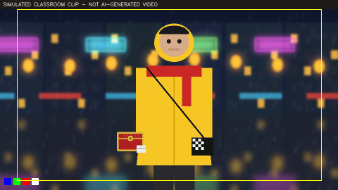
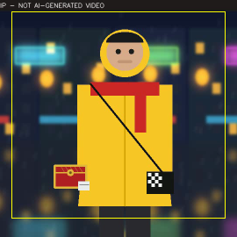
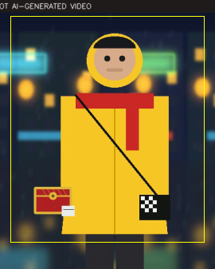
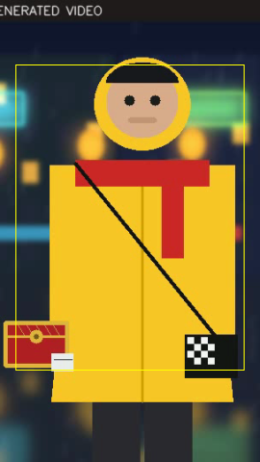
A2 · LAB 02 OUTPUT · YELLOW = PLATFORM SAFE AREA
Reframing the Same Frame for Four Platforms
16:9 master
1:1
4:5
9:16
Blocking rule for every shot of The Last Ferry: faces, the red box and all captions stay inside the centre third of the 16:9 frame.
Create Short Video Film using AI · TGS-2020505925
© 2026 Tertiary Infotech Academy Pte Ltd
49

Slide 50
K4 · SUBJECT · ACTION · ENVIRONMENT · CAMERA · STYLE · CONSTRAINTS
The Six-Field Shot Prompt
SUBJECT
Who, with the element reference: @mei in the yellow raincoat and red scarf.
ACTION
One clear action per shot: runs past neon signs, box under one arm.
1
2
ENVIRONMENT
The saved location: @night_market, rain, steam, wet ground.
CAMERA
Shot size, angle, lens, movement — described once.
3
4
STYLE
The look bible: blue hour, teal shadows, warm practicals, film grain.
CONSTRAINTS
What must not change: wardrobe colours, no extras, safe area.
5
6
Create Short Video Film using AI · TGS-2020505925
© 2026 Tertiary Infotech Academy Pte Ltd
50

Slide 51
A2 · LAB 03
Lint Before You Spend a Credit
Missing field = invented
Anything you leave out, the model decides for you.
$ python3 prompt_lab.py compose --fields data/shot2-fields-v1.json
PROMPT (28 words)
A young woman courier. runs through the market holding a box.
a busy night market at noon, neon signs. close-up wide shot.
cinematic, cinematic, cinematic film look.
LINT
- MISSING field 'constraints' - the model will invent it
- CONFLICT 'night' vs 'noon' - pick one
- CONFLICT 'close-up' vs 'wide shot' - pick one
- REPEATED ['cinematic'] - repetition dilutes
- NO references - attach the character sheet and plate
Contradictions
Night and noon cannot both win; one silently loses.
Repetition
Saying it three times does not emphasise it.
References first
@elements go at the front of every prompt.
Create Short Video Film using AI · TGS-2020505925
© 2026 Tertiary Infotech Academy Pte Ltd
51

Slide 52
K4 · JSON PROMPTING FOR REPEATABILITY
The Same Shot as a Versioned JSON Prompt
Versioned
shot2-v2 can be diffed, reviewed and rolled back.
{
"prompt_version": "shot2-v2",
"references": ["mei_sheet_v1", "night_market_plate_v1", "red_box_v1"],
"subject": "MEI: yellow hooded raincoat, red scarf, black bag ...",
"action": "runs past neon signs, the red box under one arm",
"environment": "night market, light rain, steam, wet ground",
"camera": "medium shot, eye level, 35mm, tracking left to right",
"style": "blue hour, teal shadows, warm lanterns, 35mm grain",
"constraints": "coat and scarf exactly as the sheet; no extras",
"negative": ["extra people in foreground", "text", "daylight"],
"aspect_ratio": "16:9", "resolution": "1K draft", "seed": 4127
}
Reusable
Swap one field to make the next shot.
Draft first
1K draft on a fast model; upscale only keepers.
Rewriting off
Turn automatic prompt rewriting off for long prompts.
Create Short Video Film using AI · TGS-2020505925
© 2026 Tertiary Infotech Academy Pte Ltd
52

Slide 53
A2 · LAB 03 MEASUREMENT
Locking Fields Reduces Take-to-Take Variation
Subject reference
Removes most wardrobe (coat hue) drift.
Look locked
Removes most background warmth drift.
Camera + constraints
Removes blocking and framing drift.
Leave some freedom
Crowd and steam may vary; the cast may not.
MEASURED
Measured by prompt_lab.py on 16 SIMULATED takes with a designed spread; real model output is noisier — rerun on your own takes.
Create Short Video Film using AI · TGS-2020505925
© 2026 Tertiary Infotech Academy Pte Ltd
53

Slide 54
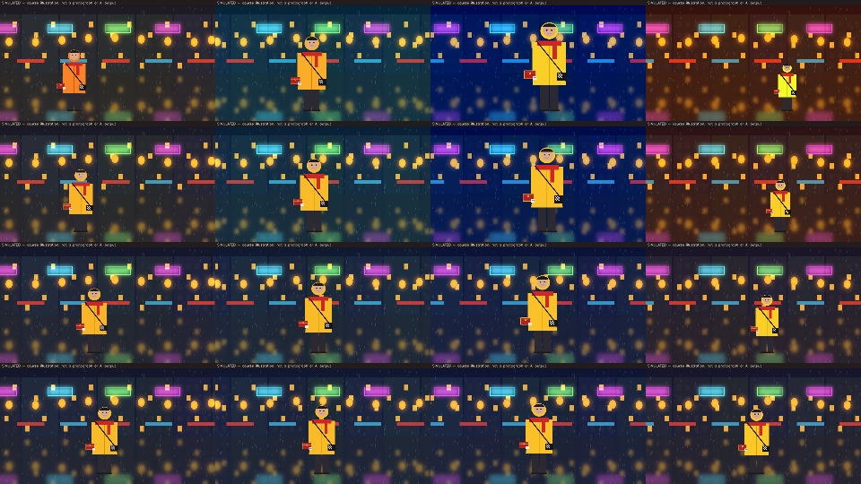
A2 · SEE THE NUMBERS
Sixteen Takes, Four Prompt Designs
Row A
Coat colour, position and size all wander.
Row B
Coat fixed by the sheet; framing still drifts.
Row C
Look fixed; blocking still moves.
Row D
Four near-identical takes: pick on performance.
Rows A→D: each row locks more fields; columns are four takes
Create Short Video Film using AI · TGS-2020505925
© 2026 Tertiary Infotech Academy Pte Ltd
54

Slide 55
K4 · CREDIT DISCIPLINE
Explore Cheap, Commit Late
DRAFT MODELS
Explore looks on a fast, cheap image model at 1K before any high-quality generation.
VARIATIONS
Ask for four variations of one prompt, not four prompts.
1
2
STILLS BEFORE VIDEO
A still costs a fraction of a clip. Approve the frame, then animate it.
UPSCALE KEEPERS ONLY
Generate at low resolution; upscale only approved takes.
3
4
Create Short Video Film using AI · TGS-2020505925
© 2026 Tertiary Infotech Academy Pte Ltd
55

Slide 56
K4 · IMAGE TRANSFORMATION AND EDITING
Editing Is Masked, Conditioned Regeneration
Inpaint
State variant
Outpaint
mask = WHITE on the object
edit inside, keep outside
same plate + 'change nothing else'
+ allowed zone
canvas 16:9 -> 9:16
mask = WHITE on new area
Remove the stray cone; the planks are continued from their surroundings.
Same pier, ferry pulling away. Verify every pixel outside the zone.
Keeps 100% of the source but must generate ~70% of the pixels.
Mask convention in this course: WHITE = edit, BLACK = preserve. Some tools use the opposite — always check.
Create Short Video Film using AI · TGS-2020505925
© 2026 Tertiary Infotech Academy Pte Ltd
56

Slide 57
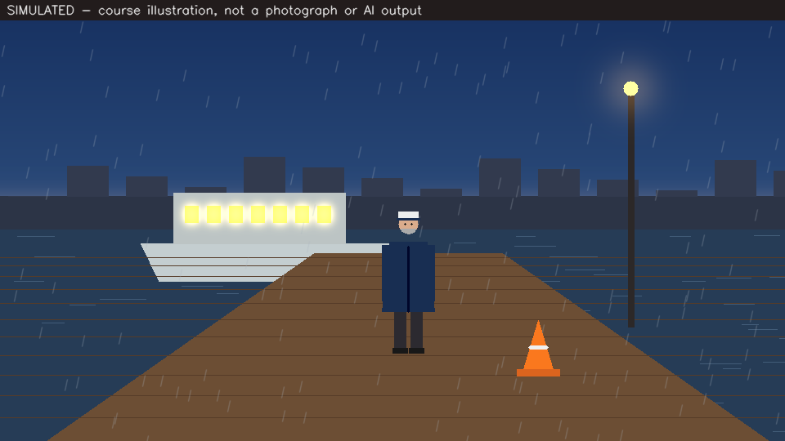
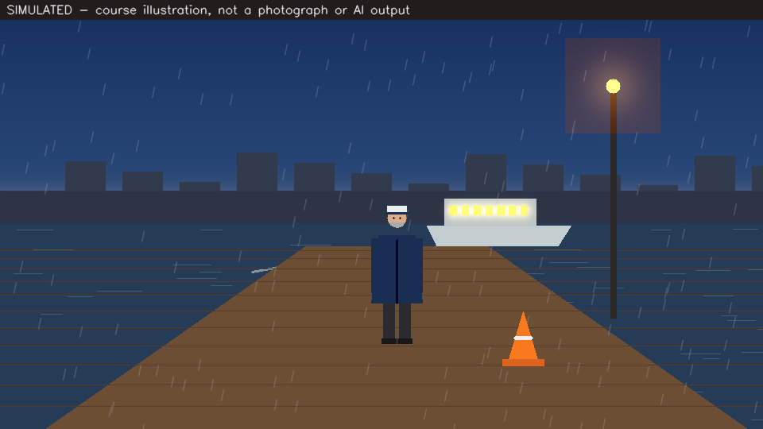
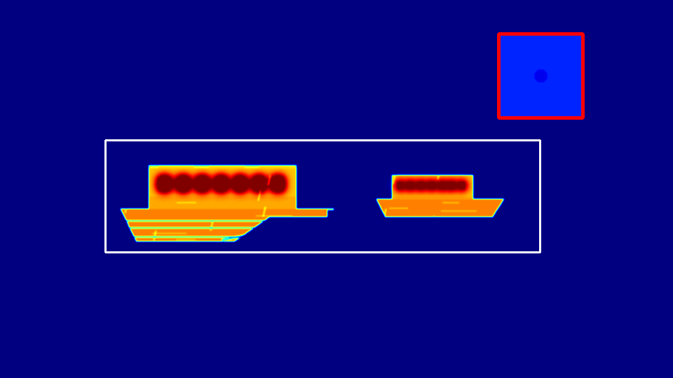
A2 · LAB 04 VERIFICATION
'Change Nothing Else' Is a Request, Not a Guarantee
State A — the plate
State B — as the model returned it
Difference: white box = allowed, red = unrequested
The ferry change sits inside the allowed zone. The lamp glow also changed (region [711, 48, 120, 120]): verdict REGENERATE, or fix the lamp with a second masked edit.
Create Short Video Film using AI · TGS-2020505925
© 2026 Tertiary Infotech Academy Pte Ltd
57

Slide 58
A2 · LAB 04 REFRAME
Crop or Outpaint for the 9:16 Cut-Down?
Crop
Nothing invented; two-thirds of the frame lost.
Outpaint
Whole frame kept; most of the picture is new.
Verify the new area
Outpainted sky and pier must match the look.
Or generate natively
A 9:16 generation avoids both costs.
MEASURED
Computed by edit_lab.py reframe on the 960x516 pier plate (banner removed).
Create Short Video Film using AI · TGS-2020505925
© 2026 Tertiary Infotech Academy Pte Ltd
58

Slide 59
K4 · PROCESSING AND FILTERING METHODS
Point Operations versus Neighbourhood Operations
Grade
Filter
• Point operation: pixel → pixel
– Each output pixel depends only on the same input pixel.
– White balance, exposure, curves, levels.
– A LUT: one lookup table per channel.
– The teal-and-orange look of the film.
– Cannot sharpen, denoise or remove blur.
• Neighbourhood operation: kernel
– Each output pixel combines its neighbours.
– Blur, denoise (bilateral, non-local means).
– Sharpen: unsharp mask, Laplacian kernel.
– Resize: nearest, cubic, Lanczos.
– Changes structure — so it can create halos.
Create Short Video Film using AI · TGS-2020505925
© 2026 Tertiary Infotech Academy Pte Ltd
59

Slide 60
K4 · FILTERS AND METRICS
Measuring an Enhancement
Unsharp mask
PSNR
SSIM
out = (1 + a) * img
- a * blur(img, s)
10 * log10(255^2 / MSE)
[l * c * s] over 11x11 windows
Per-pixel error in dB. Rewards smoothing, forgives lost texture.
Luminance, contrast and structure. Punishes lost texture PSNR forgives.
Adds back the detail a blur removes. Too large an amount a creates halos.
cv2.quality (SSIM) is contrib-only; the course ships a NumPy SSIM in ssim.py.
Create Short Video Film using AI · TGS-2020505925
© 2026 Tertiary Infotech Academy Pte Ltd
60

Slide 61
A2 · LAB 05 MEASUREMENT
Best Repair per Defect — SSIM Against the Master
Noise
The biggest gain: 0.50 → 0.93.
PSNR disagrees
PSNR prefers bilateral (34.6 dB); SSIM prefers Gaussian.
Over-sharpen
Unsharp 2.5 wins PSNR, loses SSIM: halos.
Over-clip
Levels 60-190 collapses SSIM to 0.40.
MEASURED
grade_lab.py on the SIMULATED graded master of shot S2. Best repairs: Gaussian blur, unsharp 0.8, levels 36-214, cubic x2.
Create Short Video Film using AI · TGS-2020505925
© 2026 Tertiary Infotech Academy Pte Ltd
61

Slide 62

A2 · LAB 05
Grading the Look as a Point Operation
Shadows cooler
Red minus blue in the shadows falls.
Highlights warmer
Lanterns and skin gain warmth.
Left: flat, log-like draft · Right: levels + teal-and-orange LUT
Grade stills first
Animate the graded still; the clip inherits the look.
Measure it
The warmth numbers go in the look bible (Lab 07).
Create Short Video Film using AI · TGS-2020505925
© 2026 Tertiary Infotech Academy Pte Ltd
62

Slide 63
TOPIC 02 · ELO2 · A2
Lab 02 — Frames, Formats and Aspect Ratios for Film Delivery
INPUTS
TECHNICAL QUESTION
EVIDENCE TO PRODUCE
Keyframe of shot S2 with four exact colour chips bottom-left (SIMULATED)
What does each delivery format keep of the 16:9 master, and what does the payload cost?
A clip report (shape, dtype, BGR/RGB/HSV of the calibration chips, fps, frame count, duration, bitrate, compression ratio), a contact sheet, and a reframe per delivery format with the percentage of the master each one keeps.
LAB 02 · 15 MIN · Python 3 · opencv-python · NumPy · no network
Detailed procedures and prompts: Learner Guide / labs/lab-02-frames-formats-aspect-ratios/README.md
Create Short Video Film using AI · TGS-2020505925
© 2026 Tertiary Infotech Academy Pte Ltd
63

Slide 64
TOPIC 02 · ELO2 · A2
Lab 03 — Structured Prompting for Cinematic Stills
INPUTS
TECHNICAL QUESTION
EVIDENCE TO PRODUCE
16 takes of shot S2: four prompt designs × four takes (SIMULATED, designed spread)
How much does each locked prompt field reduce the measured variation between takes?
A linted v1 prompt with its problems listed, your corrected v2 prompt in prose and JSON, and a variance table showing how much each prompt design reduced wardrobe, blocking, framing and look drift.
LAB 03 · 15 MIN · Python 3 · opencv-python · NumPy · optional: any image generator for your own takes
Detailed procedures and prompts: Learner Guide / labs/lab-03-structured-prompting-stills/README.md
Create Short Video Film using AI · TGS-2020505925
© 2026 Tertiary Infotech Academy Pte Ltd
64

Slide 65
TOPIC 02 · ELO2 · A2
Lab 04 — State Variants, Clean-Up and Reframing with Masks
INPUTS
TECHNICAL QUESTION
EVIDENCE TO PRODUCE
HARBOUR PIER state A with a stray orange cone (SIMULATED)
Which pixels changed inside and outside each edit mask, and did the edit obey 'change nothing else'?
An inpainted plate with proof that nothing outside the mask moved, a verification heat-map and verdict for the state edit, and a 9:16 crop and outpaint mask with the percentage of pixels each approach keeps or must generate.
LAB 04 · 15 MIN · Python 3 · opencv-python · NumPy · optional: an image editor or generative edit tool
Detailed procedures and prompts: Learner Guide / labs/lab-04-state-variants-reframing/README.md
Create Short Video Film using AI · TGS-2020505925
© 2026 Tertiary Infotech Academy Pte Ltd
65

Slide 66
TOPIC 02 · ELO2 · A2
Lab 05 — Cinematic Grading and Enhancement Measured with PSNR and SSIM
INPUTS
TECHNICAL QUESTION
EVIDENCE TO PRODUCE
Approved graded master of shot S2 (SIMULATED)
Which enhancement best repairs each defect by PSNR and SSIM, and do the two metrics agree?
An enhancement score table (4 defects × 3 repairs + unrepaired), a before/after sheet of the best repair per defect, and a flat-versus-graded comparison with the measured shift in shadow and highlight warmth.
LAB 05 · 15 MIN · Python 3 · opencv-python · NumPy · no network
Detailed procedures and prompts: Learner Guide / labs/lab-05-grading-enhancement-metrics/README.md
Create Short Video Film using AI · TGS-2020505925
© 2026 Tertiary Infotech Academy Pte Ltd
66

Slide 67
03
TOPIC 03
AI Visual Features, Character Consistency and Scene Design
Features as the language of consistency · character reference sheets and AI casting · local features — colour, edge, texture and keypoints · global features — histograms, statistics and moments for the look of a shot · shot size, camera angle, movement and lighting
Create Short Video Film using AI · TGS-2020505925
© 2026 Tertiary Infotech Academy Pte Ltd
67

Slide 68
LU3 · ELO3 · K5, K6, K7, A3, A4
Key Concepts — Topic 03
Consistency is a feature-matching problem
A character is 'the same' when repeatable features match across shots: wardrobe colours, silhouette, facial landmarks, a distinctive prop. The video model conditions on those features, and your QA measures them.
A character reference sheet is a feature specification
Front, side and back views plus close-ups and expressions, one outfit, fixed colours. Casting attributes — genre, era, archetype, identity, build, details, outfit — pin the look before the first shot is generated.
1
2
Local features answer 'what is here?'
Dominant colour in HSV, Canny edges of the silhouette, texture energy and ORB keypoints on the face or prop. They are compared crop to crop, so they catch a scarf that changed colour or a prop that lost its clasp.
Global features answer 'does this whole shot belong?'
HSV histograms compared with Bhattacharyya distance, mean luminance, contrast, warm/cool balance and Hu moments of the composition mask. Together they form a numeric 'look bible' that every shot must stay close to.
3
4
Scene design is composition, camera and light
Shot size (wide, medium, close-up), angle (eye-level, low, high, over-the-shoulder), movement (push-in, pan, tracking, handheld) and lighting (key, fill, rim, practicals, blue hour). The rule of thirds and the 180-degree rule keep a cut readable.
Locations and props need angles and states
Generate a multi-angle location grid and each story state of a location (ferry docked, ferry leaving) as its own reference, plus a clean hero plate of every prop. The model reuses what you give it and invents what you don't.
5
6
Create Short Video Film using AI · TGS-2020505925
© 2026 Tertiary Infotech Academy Pte Ltd
68

Slide 69
K5 · FEATURE EXTRACTION AND REPRESENTATION
Consistency is a feature-matching problem.
A character is 'the same' across shots when repeatable features match: wardrobe colours, silhouette, a face, a distinctive prop. The generator conditions on those features — and your quality check measures them.
Create Short Video Film using AI · TGS-2020505925
© 2026 Tertiary Infotech Academy Pte Ltd
69

Slide 70
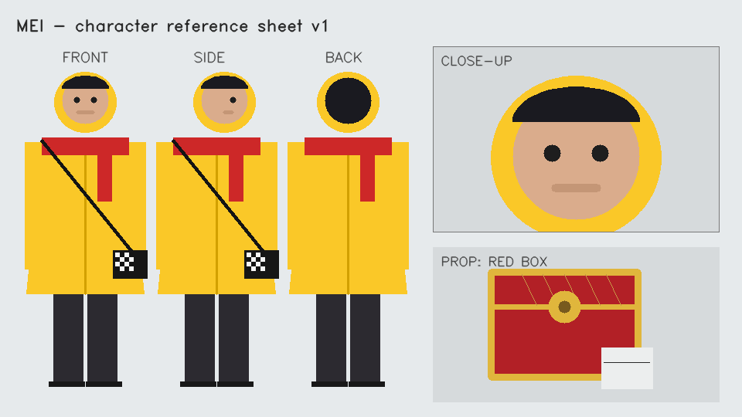
A4 · DESIGN THE FEATURES BEFORE THE SHOTS
A Reference Sheet Is a Feature Specification
Three views
Front, side and back fix the silhouette from every angle.
Close-up
Face, scarf and the chequered bag patch at full detail.
One outfit
Fixed colours: yellow raincoat, red scarf, black bag.
Save as an element
Name it (@mei) and reuse it — never re-describe her.
MEI — front, side, back, close-up and the RED BOX prop
Create Short Video Film using AI · TGS-2020505925
© 2026 Tertiary Infotech Academy Pte Ltd
70

Slide 71
K5 · STRUCTURED CASTING ATTRIBUTES
Casting a Character Without a Photo
GENRE
Sets the visual register: drama, action, thriller, romance.
BUDGET AND ERA
Production scale and period shape wardrobe and grooming.
1
2
ARCHETYPE
The role in the story: hero, sage, innocent, rebel.
IDENTITY
Gender, age and ethnicity chosen deliberately, not left to chance.
3
4
BUILD AND DETAILS
Body type, height, facial hair, scars, tattoos.
OUTFIT
One costume, specified exactly — it is the strongest feature.
5
6
Create Short Video Film using AI · TGS-2020505925
© 2026 Tertiary Infotech Academy Pte Ltd
71

Slide 72
K5 · ASSET MANAGEMENT KEEPS THE CAST CONSISTENT
Generate, Approve, Save, Reuse
1
2
3
4
5
Generate the sheet — cheap draft model first
Approve against the character brief
Save as a named element (@mei, @red_box)
Reference the element in every still and shot
Measure each shot against the sheet (Lab 06)
The model then loads the same approved reference every time instead of reading a fresh description and guessing.
Create Short Video Film using AI · TGS-2020505925
© 2026 Tertiary Infotech Academy Pte Ltd
72

Slide 73
K6 · LOCAL FEATURES: EDGE, COLOUR, TEXTURE, KEYPOINTS
Local Features and the Failure Each One Catches
Feature
How it is computed
Catches
Blind to
Coat hue
Median OpenCV hue inside the coat mask
Wardrobe colour drift
Shape changes
Scarf red cover
Share of red pixels in the upper body
Scarf changed or missing
Which red
Edge density
Canny edge pixels / crop pixels
Silhouette and detail changes
Colour
Texture energy
Variance of the Laplacian
Plastic, over-smoothed faces
Identity
ORB matches
Keypoints + Hamming + ratio test vs the sheet
A different patch, face or prop
Colour: it runs on grey
Clasp window
Brass pixels inside the clasp box only
Lost prop detail
Anything outside the window
No single feature sees everything. The check is a designed combination — that design is ability A4.
Create Short Video Film using AI · TGS-2020505925
© 2026 Tertiary Infotech Academy Pte Ltd
73

Slide 74
A4 · IMPLEMENT THE FEATURE EXTRACTION
Matching Keypoints to the Reference Sheet
ORB descriptors are binary
32 bytes per keypoint; compare with Hamming.
orb = cv2.ORB_create(nfeatures=800)
ka, da = orb.detectAndCompute(sheet_gray, None)
kb, db = orb.detectAndCompute(shot_gray, None)
pairs = cv2.BFMatcher(cv2.NORM_HAMMING).knnMatch(da, db, k=2)
good = [m for m, n in pairs if m.distance < 0.75 * n.distance]
hsv = cv2.cvtColor(crop, cv2.COLOR_BGR2HSV)
coat = cv2.inRange(hsv, (5,150,170), (40,255,255)) > 0
hue = np.median(hsv[..., 0][coat]) # sheet: 23
Ratio test
Keep a match only if clearly better than the runner-up.
Resize crops first
Bring both to the same height so scale is comparable.
Hue in OpenCV
0–179 in 8-bit: yellow sits near 22–23.
VERIFY character_features.py in Lab 06 runs this on six shots.
Create Short Video Film using AI · TGS-2020505925
© 2026 Tertiary Infotech Academy Pte Ltd
74

Slide 75
A4 · LAB 06 RESULT
Six Shots of MEI Against Her Reference Sheet
shot 04: DRIFT
Scarf red cover 0.00 — the scarf turned blue.
shot 05: DRIFT
Clasp brass 0.14 — the clasp is missing.
shot 06: DRIFT
Coat hue 13, not 23 — the coat drifted to orange.
Keypoints miss colour
shot 06 still gets 12 ORB matches.
MEASURED
character_features.py on SIMULATED shots with injected drift.
Create Short Video Film using AI · TGS-2020505925
© 2026 Tertiary Infotech Academy Pte Ltd
75

Slide 76
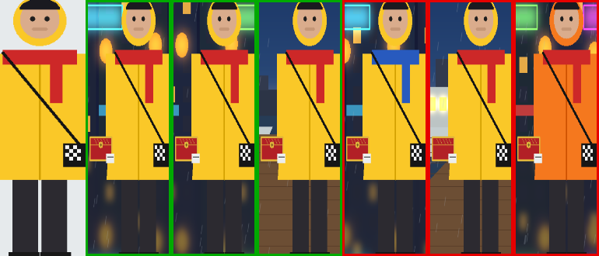
A4 · VISUAL EVIDENCE BESIDE THE NUMBERS
The Identity Strip
Sheet crop first, then shots 01–06 · green = consistent, red = drift
Regenerate shots 04, 05 and 06 with the sheet re-attached and the drifted feature named in the constraints.
Create Short Video Film using AI · TGS-2020505925
© 2026 Tertiary Infotech Academy Pte Ltd
76

Slide 77
K6 · K7 · SCOPE IS A DESIGN DECISION
Local versus Global Features
Lab 06
Lab 07
• Local: what is HERE?
– Computed on a crop or a point.
– Edges, corners, colour patches, ORB keypoints, optical flow.
– Answers: is this still MEI? is the clasp there?
– Used for character and prop consistency.
• Global: what is this WHOLE shot like?
– Computed on the whole frame.
– Histograms, mean brightness, contrast, warmth, tint, moments.
– Answers: does this shot belong in this film?
– Used for the look bible and scene continuity.
Create Short Video Film using AI · TGS-2020505925
© 2026 Tertiary Infotech Academy Pte Ltd
77

Slide 78
K7 · GLOBAL FEATURE DESCRIPTIONS: STATISTICAL AND GEOMETRICAL
A Numeric Fingerprint for the Look
Histogram distance
Statistics
Geometry
d_B(H1, H2) =
sqrt(1 - sum sqrt(H1*H2))
mean V, std V, mean S
warmth = mean(R - B)
tint = mean(G - (R+B)/2)
Hu moments of the
bright-practicals mask
Bhattacharyya distance of normalised hue/saturation histograms: 0 = same palette.
Where the light sits in the frame — invariant to position and scale.
Exposure, contrast, saturation, white balance and green/magenta cast.
Each shot is compared with the approved master of ITS OWN location.
Create Short Video Film using AI · TGS-2020505925
© 2026 Tertiary Infotech Academy Pte Ltd
78

Slide 79
A3 · LAB 07 RESULT
Auditing Eight Shots Against the Look Bible
shot 05 OFF LOOK
Exposure +45, warmth +38: a 'noon' generation.
shot 07 OFF LOOK
Tint −39, saturation +54: a magenta cast.
Six shots ON LOOK
Every delta well inside the limits.
Regrade or regenerate?
A LUT can fix a cast; not daylight.
MEASURED
look_audit.py: each shot minus its location master. Limits: exposure 15, warmth 20, tint 12.
Create Short Video Film using AI · TGS-2020505925
© 2026 Tertiary Infotech Academy Pte Ltd
79

Slide 80
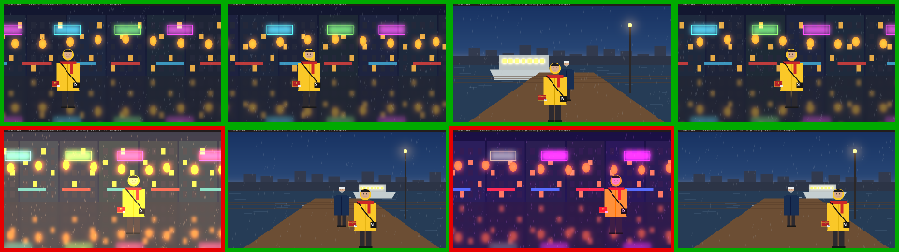
A3 · LAB 07 VISUAL EVIDENCE
The Look Strip
Shots 01–08 · green = on look, red = off look
Compare with one master for the whole film: every market shot would be flagged — a single master punishes legitimate differences between locations.
Create Short Video Film using AI · TGS-2020505925
© 2026 Tertiary Infotech Academy Pte Ltd
80

Slide 81
SCENE DESIGN · WRITE IT INTO EVERY SHOT PROMPT
Shot Size and Camera Angle Vocabulary
Term
Frames
Use in The Last Ferry
Wide / establishing
Whole location, figures small
S1 market, S4 pier
Medium
Waist up
S2 Mei running
Close-up
Face or object fills the frame
S3 the red box
Two-shot / over-the-shoulder
Two characters, one favoured
S5 the hand-over
Low angle
Camera below eye line: stature, emotion
S6 Mei reads the tag
High angle
Camera above: vulnerability, detail
S3 box in her hands
Create Short Video Film using AI · TGS-2020505925
© 2026 Tertiary Infotech Academy Pte Ltd
81

Slide 82
SCENE DESIGN · CINEMATIC LANGUAGE
Movement, Light and Composition
CAMERA MOVEMENT
Locked-off, pan, tilt, push-in, tracking, crane, handheld — one move per shot.
SPEED
Real-time or slow motion (speed ramp) for a single beat.
1
2
KEY, FILL, RIM
Key sets the mood, fill controls contrast, rim separates the subject.
PRACTICALS
Visible light sources — lanterns, the sodium lamp — motivate the grade.
3
4
RULE OF THIRDS
Eyes and the prop on third lines; keep the centre third for 9:16.
180-DEGREE RULE
Keep the camera on one side of the action so directions read.
5
6
Create Short Video Film using AI · TGS-2020505925
© 2026 Tertiary Infotech Academy Pte Ltd
82

Slide 83

K5 · LOCATION AND PROP REFERENCES
Locations Need Angles and Story States
NIGHT MARKET plate
HARBOUR PIER — state A: ferry docked
HARBOUR PIER — state B: ferry leaving
Generate state B by EDITING state A ('change nothing else') and verify it (Lab 04) — otherwise the model invents a different pier.
Create Short Video Film using AI · TGS-2020505925
© 2026 Tertiary Infotech Academy Pte Ltd
83

Slide 84
TOPIC 03 · ELO3 · A4
Lab 06 — Character Reference Sheets and Consistency Features
INPUTS
TECHNICAL QUESTION
EVIDENCE TO PRODUCE
MEI reference sheet: front, side, back, close-up and the RED BOX (SIMULATED)
Which local features catch a changed scarf, a drifted coat and a missing clasp — and which miss them?
A feature-extraction design (which feature detects which failure), an identity report for six shots with pass/drift verdicts and reasons, and an identity strip comparing each shot crop with the reference sheet.
LAB 06 · 30 MIN · Python 3 · opencv-python · NumPy · optional: an image model with character references
Detailed procedures and prompts: Learner Guide / labs/lab-06-character-consistency-features/README.md
Create Short Video Film using AI · TGS-2020505925
© 2026 Tertiary Infotech Academy Pte Ltd
84

Slide 85
TOPIC 03 · ELO3 · A3
Lab 07 — Look Bible and Scene Continuity with Global Descriptors
INPUTS
TECHNICAL QUESTION
EVIDENCE TO PRODUCE
Approved look master, NIGHT MARKET (SIMULATED)
Which global descriptor identifies each off-look shot, and why must shots be compared with their own location?
A look report for eight shots with the descriptor that moved for every off-look shot, a colour-coded look strip, and a look bible with the limits you would ship.
LAB 07 · 30 MIN · Python 3 · opencv-python · NumPy · no network
Detailed procedures and prompts: Learner Guide / labs/lab-07-look-bible-scene-continuity/README.md
Create Short Video Film using AI · TGS-2020505925
© 2026 Tertiary Infotech Academy Pte Ltd
85

Slide 86
04
TOPIC 04
AI Video Generation, Animation and Video Analytics
Deep learning for video — temporal coherence, start/end frames and video references · multi-shot and timeline prompting with dialogue and emotion · detecting and verifying the cast · voiceover-first sound design, captions and export · shot, motion, tracking and drift analytics
Create Short Video Film using AI · TGS-2020505925
© 2026 Tertiary Infotech Academy Pte Ltd
86

Slide 87
LU4 + LU5 · ELO4 + ELO5 · K8, K9, K10, A5, A6
Key Concepts — Topic 04
Deep video models learn motion from data
Convolution and attention layers learn spatial structure; temporal attention links frames. Each frame must look right (spatial coherence) AND agree with its neighbours (temporal coherence): flicker, morphing and identity drift are temporal failures.
Continuity is conditioned, shot to shot
A start frame fixes where a shot begins; an end frame fixes where it lands. A video reference or extension passes the whole previous clip, so lighting, mood and motion carry across the cut. Clips are typically capped at 5-15 s.
1
2
Write shots, not paragraphs
Multi-shot prompts list Shot 1, Shot 2, Shot 3 in order; timeline prompts give second-by-second beats. Dialogue goes in quotation marks, and each character gets an emotion and an intensity. Dense action: generate three takes and pick.
Detection and segmentation turn frames into evidence
A face or person detector counts the cast in every shot; a segmentation mask isolates the subject for grading. Evaluate detectors with IoU, precision and recall before you trust them to approve a shot.
3
4
Video analytics finds cuts, motion, drift and events
Histogram differences find shot boundaries; optical flow classifies camera movement; CAMShift tracks the courier's raincoat; hue drift and luminance flicker become numbers; the first frame the subject appears is an event.
Sound drives picture
Generate the voiceover first and cut the storyboard to its timing. Direct delivery with audio tags, score music by mood and tempo, add sound effects, then caption inside the safe area and export one master per platform.
5
6
Create Short Video Film using AI · TGS-2020505925
© 2026 Tertiary Infotech Academy Pte Ltd
87

Slide 88
K8 · DEEP LEARNING CONCEPTS FOR VIDEO
Spatial Coherence versus Temporal Coherence
Within a frame
Across frames
• Spatial: is each frame right?
– Anatomy, perspective, text, lighting in one frame.
– Checked frame by frame.
– Image models have mostly solved this.
• Temporal: do the frames agree?
– Identity, wardrobe and background stay put.
– Motion obeys physics; no flicker, no morphing.
– A per-frame score cannot see it.
– The defining problem of AI video.
Lab 10 measures the temporal failures — flicker and identity drift — that a frame-by-frame review misses.
Create Short Video Film using AI · TGS-2020505925
© 2026 Tertiary Infotech Academy Pte Ltd
88

Slide 89
K8 · ARCHITECTURE
Inside a Video Diffusion Transformer
CONDITIONS
Text prompt · element reference images · start / end frame · previous clip
Why clips are short
Attention cost grows with the square of the token count.
VAE ENCODER
Compresses frames into a small latent: 8x smaller per side, and in time
Why references help
They are extra tokens the model attends to.
PATCHIFY
Cuts the latent video into spatiotemporal patches — the tokens
TRANSFORMER
Spatial + temporal attention denoises all tokens together over S steps
Why takes differ
Each take starts from different noise.
VAE DECODER
Turns the clean latent back into frames (some models also emit audio)
Create Short Video Film using AI · TGS-2020505925
© 2026 Tertiary Infotech Academy Pte Ltd
89

Slide 90
K8 · COMPUTE AND CLIP LENGTH
Why Clips Are Capped at a Few Seconds
Tokens
Attention
Credits
N = (F/f) x (H/p) x (W/p)
cost ~ N^2
generated s = sum(seconds x takes)
F frames, H x W latent, compressed by f in time and p in space.
Doubling the duration roughly quadruples full attention cost.
The Last Ferry: 48 s finished, about 98 s generated with extra takes.
Typical caps today are 4–15 seconds per clip. Longer scenes are built from shots joined by start/end frames or video extension.
Create Short Video Film using AI · TGS-2020505925
© 2026 Tertiary Infotech Academy Pte Ltd
90

Slide 91
A5 · APPLYING THE MODEL WITH CONTROL
Continuity Controls — What Each One Fixes
Control
You give the model
It fixes
Limitation
Element references
Saved character, location, prop images
Who and where
Not the motion
Start frame
The graded still the shot begins on
Composition, look, placement
The end can wander
Start + end frame
Where the shot begins and lands
The whole path of the shot
Mood can reset at the cut
Video reference / extension
The entire previous clip
Light, mood, motion across the cut
Errors carry over too
Takes
Several generations of one shot
Luck: pick the best performance
Multiplies credits
Create Short Video Film using AI · TGS-2020505925
© 2026 Tertiary Infotech Academy Pte Ltd
91

Slide 92
A5 · SEEN IN CURRENT CINEMATIC VIDEO TOOLS
Director Controls in a Video Generator
GENRE AND STYLE
Action, drama, horror — sets pacing and visual register.
CAMERA MOVEMENT
Choose one move, or let the model pick for a single beat.
1
2
SPEED RAMP
Slow motion on one moment, real time elsewhere.
DURATION, RESOLUTION, ASPECT
Draft short and small; match the delivery ratio.
3
4
EMOTION AND INTENSITY
Per character: vigilance, rage, trust — low to high.
AUDIO ON / OFF
Native dialogue and ambience, or silent for your own mix.
5
6
Create Short Video Film using AI · TGS-2020505925
© 2026 Tertiary Infotech Academy Pte Ltd
92

Slide 93
A5 · LAB 09 SHOT S5
A Multi-Shot Prompt with Dialogue and Emotion
Shots in order
One line per shot so the model need not guess timing.
@mei @captain_tan @harbour_pier_docked @red_box
Duration 6 s, 16:9, medium two-shot, over-the-shoulder, static.
Shot 1: MEI, out of breath, holds out the red box.
Shot 2: CAPTAIN TAN (warm, intensity medium) does not take it;
he nods at the folded tag.
CAPTAIN TAN: "It's not for me. Read the tag."
Shot 3: close on MEI's face (curious, intensity low).
Look: blue hour, teal shadows, warm sodium lamp, light rain.
Constraints: coat and scarf exactly as @mei; no extra people.
Dialogue in quotes
Read as a voice line for that character.
Emotion per character
With an intensity, like directing a cast.
Constraints last
What must not change, stated plainly.
Create Short Video Film using AI · TGS-2020505925
© 2026 Tertiary Infotech Academy Pte Ltd
93

Slide 94
A5 · GENERATED BY storyboard.py prompts
A Timeline Prompt, Second by Second
Beats have times
The voice line lands where the VO was recorded.
SHOT S1 (8 s, 16:9) — wide, eye level, slow pan right, 24mm
[0.0s] Lanterns sway; the camera finds MEI in the crowd.
[1.0s] MEI (V.O.) (breathless, medium):
"Last ferry leaves at midnight. Four minutes."
[5.0s] She checks her watch without slowing.
Start frame: reference/board/shot1_start.png
End frame: reference/board/shot1_end.png
Takes: 1 Negative: extras in foreground, text, daylight
Start and end frames
Fix where the shot begins and lands.
Takes by density
S2 is dense action: three takes.
Three formats
Prose, timeline and JSON for every shot.
Create Short Video Film using AI · TGS-2020505925
© 2026 Tertiary Infotech Academy Pte Ltd
94

Slide 95
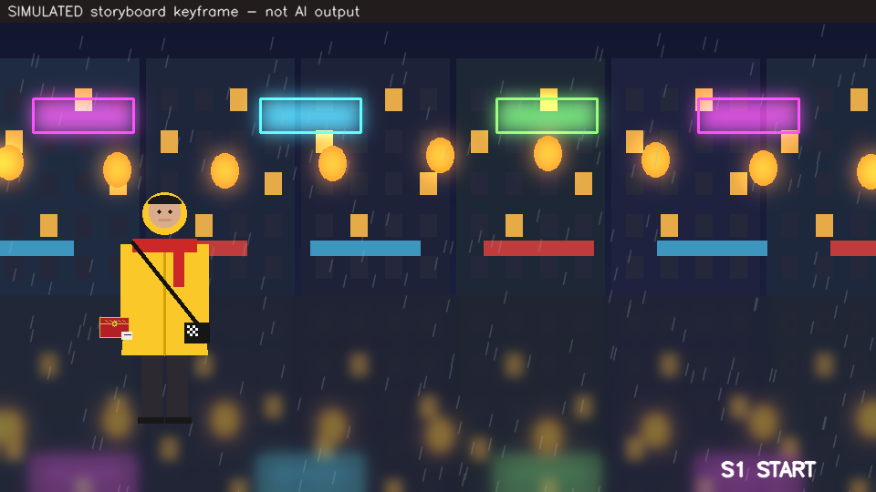
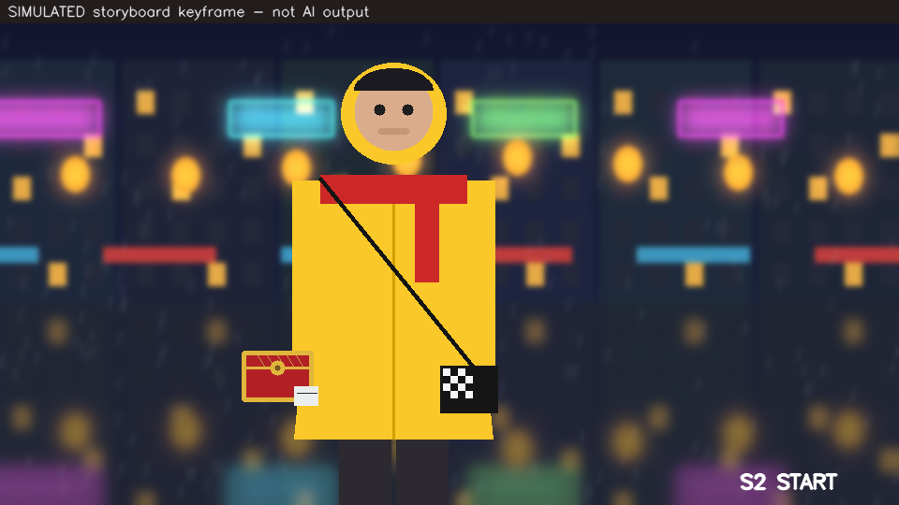
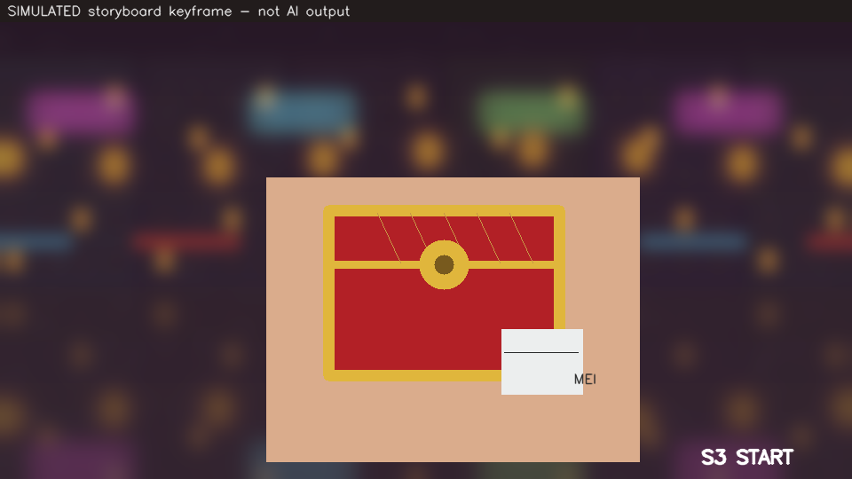
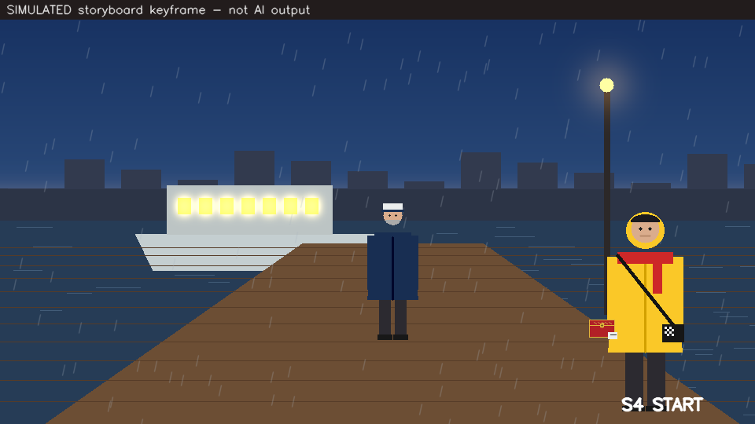
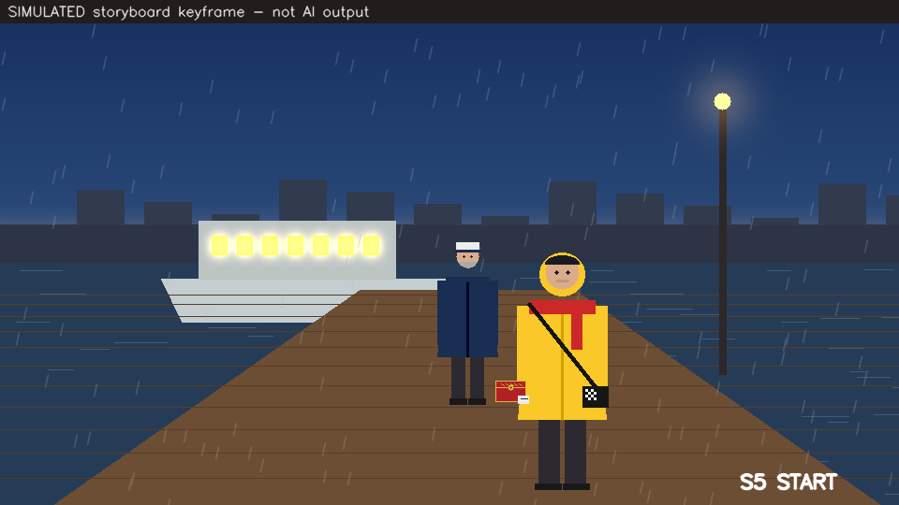
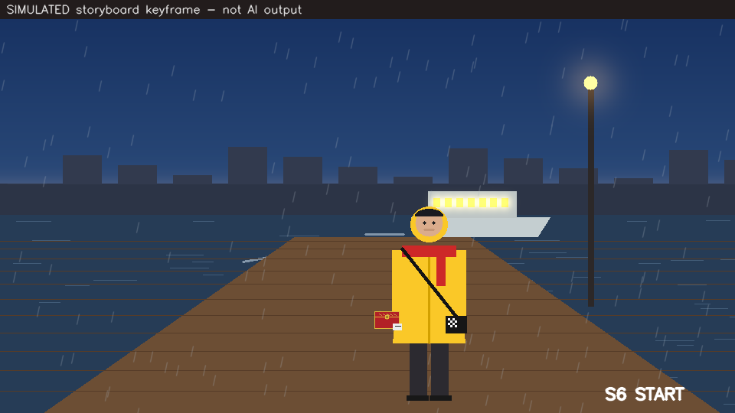
A5 · LAB 09 · LOCK TIMING BEFORE SPENDING CREDITS
The Storyboard: Start Frames of Six Shots
S1 wide · 8 s
S2 medium · 8 s
S3 close-up · 6 s
S4 wide · 8 s
S5 two-shot · 6 s
S6 low angle · 12 s
The check finds two problems: S6 exceeds the 10-second clip cap (split it into S6 + an extension S7) and one voice line crosses a cut.
Create Short Video Film using AI · TGS-2020505925
© 2026 Tertiary Infotech Academy Pte Ltd
95

Slide 96
K8 · THE CREDIT BUDGET OF A 48-SECOND FILM
Seconds Generated per Shot, Including Takes
2x overhead
Extra takes double the generated seconds.
Dense action
S2 gets three takes; S7 extends S6 with one.
Draft first
Generate low-resolution drafts, upscale keepers.
Plan the takes
Takes are a budget line, not an accident.
MODELLED
From the Lab 12 production plan: seconds x takes per shot. 48 finished seconds cost 98 generated seconds.
Create Short Video Film using AI · TGS-2020505925
© 2026 Tertiary Infotech Academy Pte Ltd
96

Slide 97
K9 · OBJECT SEGMENTATION, DETECTION AND RECOGNITION
Classification, Detection, Segmentation
Classification
Detection
Segmentation
• One label per image.
• 'Is this shot at night?'
• Metric: accuracy, F1.
• Cheapest; least detail.
• A box + label + score per object.
• 'How many faces are on screen?'
• Metric: IoU, precision, recall.
• Lab 08: cast presence.
• A label per pixel.
• 'Which pixels are Mei's raincoat?'
• Metric: mask IoU.
• Labs 10–11: tracking, reframing.
Create Short Video Film using AI · TGS-2020505925
© 2026 Tertiary Infotech Academy Pte Ltd
97

Slide 98
A5 · K9 · EVALUATION
Evaluating a Detector Before You Trust It
IoU
Match
Precision / recall
|A ∩ B| / |A ∪ B|
same class, IoU >= t,
one-to-one, best score first
P = TP/(TP+FP)
R = TP/(TP+FN)
F1 = 2PR/(P+R)
[0,0,100,100] vs [50,0,100,100] = 5000 / 15000 = 0.333.
Unmatched predictions are FP; unmatched truths are FN.
State the IoU threshold with every number.
Create Short Video Film using AI · TGS-2020505925
© 2026 Tertiary Infotech Academy Pte Ltd
98

Slide 99
A5 · LAB 08 RESULT
Two Built-In Detectors at Three IoU Thresholds
Face cascade
One false positive; tight boxes at every IoU.
HOG people
Right objects, loose box edges: collapses at 0.7.
Positive control
On an AI-generated photo-real still, many false positives.
Domain shift
Evaluate on your own footage before automating.
MEASURED
detect_eval.py on 12 SIMULATED schematic storyboard frames with exact truth. Does not transfer to photographic footage.
Create Short Video Film using AI · TGS-2020505925
© 2026 Tertiary Infotech Academy Pte Ltd
99

Slide 100
A5 · LAB 08 CAST PRESENCE
Cast Check: Is the Frame Wrong, or the Detector?
Frame
Shot list expects
Detector sees
Truth
Verdict
frame_04
2 faces
1
1
CAST DRIFT — a character is missing
frame_06
1 face
2
1
DETECTOR ERROR — false positive
frame_09
1 face
2
2
CAST DRIFT — an extra appeared
9 others
as listed
as listed
as listed
OK
Only a disagreement between the shot list and the detector is routed to a reviewer; the truth column is what the reviewer decides.
Create Short Video Film using AI · TGS-2020505925
© 2026 Tertiary Infotech Academy Pte Ltd
100

Slide 101
TOPIC 04 · ELO4 · A5
Lab 08 — Cast-Presence Detection and Detector Evaluation
INPUTS
TECHNICAL QUESTION
EVIDENCE TO PRODUCE
Twelve schematic storyboard frames with exact truth (SIMULATED)
How do confidence and IoU thresholds change false positives and misses — and is a flagged frame wrong, or is the detector?
An evaluation table (TP, FP, FN, precision, recall, F1 at three IoU thresholds), a parameter sweep with a chosen operating point, a cast-check table separating CAST DRIFT from DETECTOR ERROR, and a positive-control run on an AI-generated still.
LAB 08 · 60 MIN · Python 3 · opencv-python · NumPy · no weights download, no network
Detailed procedures and prompts: Learner Guide / labs/lab-08-cast-detection-evaluation/README.md
Create Short Video Film using AI · TGS-2020505925
© 2026 Tertiary Infotech Academy Pte Ltd
101

Slide 102
TOPIC 04 · ELO4 · A5, A6
Lab 09 — Storyboard to Shot Prompts, Start and End Frames, and the Animatic
INPUTS
TECHNICAL QUESTION
EVIDENCE TO PRODUCE
Storyboard start and end keyframes for six shots (SIMULATED)
Do the shot durations, clip-length cap and voiceover timing agree — before any credit is spent?
A corrected shot list that passes every check, a shot-prompt pack (prose, timeline and JSON per shot, with start/end frames and takes), and a 48-second animatic with the voiceover lines burned in.
LAB 09 · 30 MIN · Python 3 · opencv-python · NumPy · optional: any image-to-video model with start/end frames
Detailed procedures and prompts: Learner Guide / labs/lab-09-storyboard-shot-prompts/README.md
Create Short Video Film using AI · TGS-2020505925
© 2026 Tertiary Infotech Academy Pte Ltd
102

Slide 103
K10 · ACTIVITY TRACKING, SCENE UNDERSTANDING, EVENT DISCOVERY
Video Analytics on the Assembled Sequence
1 CUTS
2 MOTION
3 FLICKER
4 TRACK
5 DRIFT + EVENTS
Pixel-difference jump AND histogram change mark a shot boundary.
Background feature flow + RANSAC: pan or static?
Frame-to-frame brightness jumps inside a shot.
CAMShift on the raincoat's hue back-projection.
Coat hue over time; the frame Mei first appears.
SO WHAT Each measure answers one editorial question — where are the cuts, what does the camera do, which shot flickers, who drifts, and when does she enter — with a number and a timecode.
Create Short Video Film using AI · TGS-2020505925
© 2026 Tertiary Infotech Academy Pte Ltd
103

Slide 104
A6 · DESIGN THE VIDEO ANALYTICS
Three Analytics Rules
Cut
Flicker index
Identity drift
diff_t > max(12, 5 x median(diff_recent))
AND hist_dist_t > 0.08
mean | L_t - L_(t-1) |
L = mean frame brightness
hue_end - hue_start
of the tracked coat
A flicker passes the first test but not the second: brightness changes, palette does not.
Above 4 inside one shot = a flickering generation.
More than 4 hue units within one shot = the character changed.
Every threshold is a design decision: report the value and the evidence for it.
Create Short Video Film using AI · TGS-2020505925
© 2026 Tertiary Infotech Academy Pte Ltd
104

Slide 105
A6 · LAB 10 RESULT
Flicker Index per Shot
Cuts: 4 of 4
Frames 72, 168, 216, 312 — no false cuts.
S1 pans right
Background moves about −5 px per frame.
S3 flickers
6.06 against a threshold of 4.
Mei enters at 3.00 s
Frame 72 — the event for the edit list.
MEASURED
continuity.py on the SIMULATED 16-second sequence with an injected flicker in S3. Threshold 4.0.
Create Short Video Film using AI · TGS-2020505925
© 2026 Tertiary Infotech Academy Pte Ltd
105

Slide 106
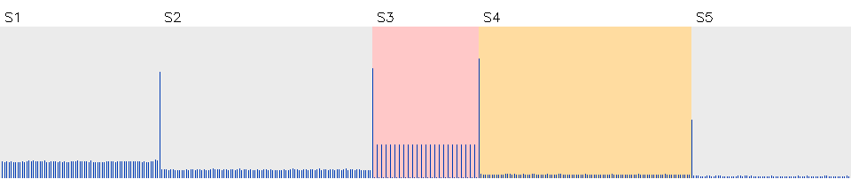
A6 · LAB 10 VISUAL EVIDENCE
The Continuity Timeline
S2 tracked cleanly
IoU(x) 0.82, jitter 1 px, coat hue steady at 23.
S4 drifts
Coat hue 23 → 13 across the shot.
Blue spikes = frame differences (cuts) · red = flicker shot · orange = drift shot
Drift breaks tracking
The colour tracker loses her as the hue leaves.
Fix
Regenerate S4 with @mei re-attached; video-reference S3.
Create Short Video Film using AI · TGS-2020505925
© 2026 Tertiary Infotech Academy Pte Ltd
106

Slide 107
A6 · K10 · ACTIVITY TRACKING
Tracking the Subject
Mechanism
Use
• How CAMShift follows MEI
– Build a hue histogram of the raincoat in the first box.
– Back-project it: each pixel scores 'how raincoat-like'.
– Climb to the densest window; adapt its size and angle.
– Repeat every frame — no training data needed.
• Why it matters for the film
– Subject-following crops for the 9:16 cut-down.
– Jitter and scale drift expose unstable generations.
– A colour tracker fails when the colour drifts.
– That failure is itself evidence of identity drift.
Create Short Video Film using AI · TGS-2020505925
© 2026 Tertiary Infotech Academy Pte Ltd
107

Slide 108
A6 · SOUND DESIGN AND FINISHING
Sound Drives Picture
1
2
3
4
5
6
Generate the voiceover FIRST and measure each line
Cut the storyboard to the voice timing
Direct delivery with audio tags per line
Score music by mood and tempo
Add effects; duck music under the voice
Caption inside the safe area; export
Keep one voice ID per character across every clip, or the voice changes between shots even when the face does not.
Create Short Video Film using AI · TGS-2020505925
© 2026 Tertiary Infotech Academy Pte Ltd
108

Slide 109
A6 · LAB 11 · BURNED-IN CAPTIONS CANNOT BE EDITED LATER
Caption Rules the Export Checks
Rule
Limit
Why
Lines per caption
2
More covers the picture
Characters per line
42
Readable on a phone
Reading speed
17 characters / second
Viewers must finish the line
On screen
1.0 – 7.0 seconds
Too short flashes; too long lingers
Gap between captions
≥ 0.08 seconds
Separate lines read as separate lines
Position
Inside the platform safe area
Buttons and handles cover the rest
Create Short Video Film using AI · TGS-2020505925
© 2026 Tertiary Infotech Academy Pte Ltd
109

Slide 110
A6 · LAB 11 RESULT
The Export Ladder
Subject-following crop
The 9:16 and 4:5 crops follow Mei's raincoat mask.
Mix
Peak −1.5 dBFS; voice 13 dB over the ducked music.
Label travels
The SIMULATED banner is re-burned on every derivative.
Disclosure
Set the platform's AI-content label on upload.
MEASURED
finish.py: 240 frames per export; with FFmpeg each is muxed to H.264 video + AAC audio and verified with ffprobe.
Create Short Video Film using AI · TGS-2020505925
© 2026 Tertiary Infotech Academy Pte Ltd
110

Slide 111
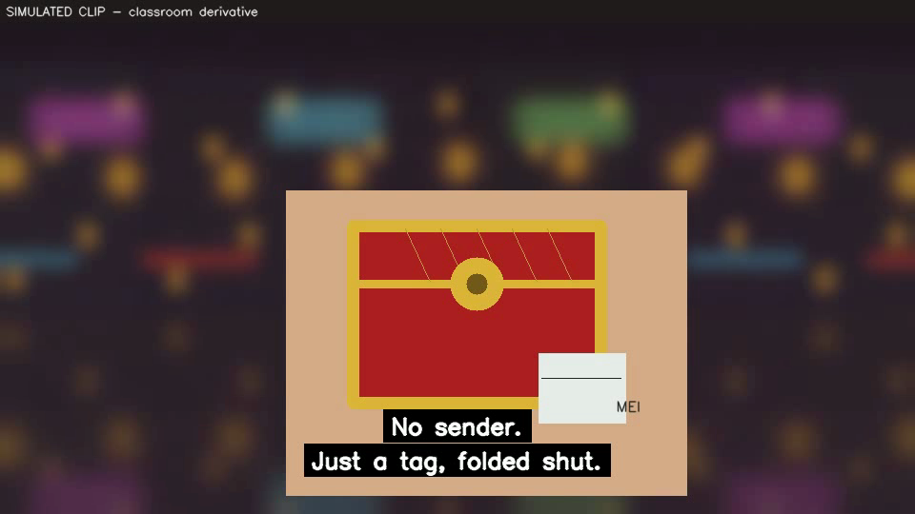
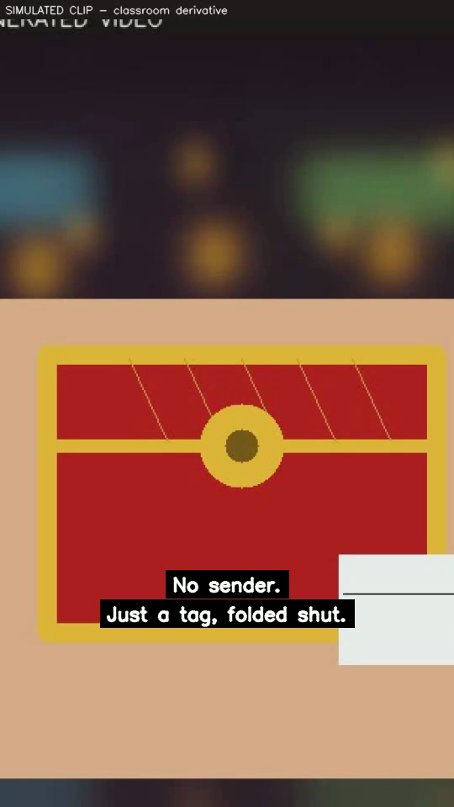
A6 · LAB 11 OUTPUT
Finished Frames: Master and Reel
16:9 master with captions
9:16 Reel: subject-following crop, captions above the UI zone
Create Short Video Film using AI · TGS-2020505925
© 2026 Tertiary Infotech Academy Pte Ltd
111

Slide 112
TOPIC 04 · ELO5 · A6
Lab 10 — Shot, Motion and Continuity Analytics on the Assembled Sequence
INPUTS
TECHNICAL QUESTION
EVIDENCE TO PRODUCE
16-second, five-shot sequence with injected flicker and identity drift (SIMULATED clip)
Do the cut detector, camera-motion estimate, flicker index, tracker and hue-drift measure tell the same story as the truth file?
A shot report (boundaries, camera movement, flicker), a tracking report (IoU, centre error, jitter, hue drift), the first-appearance event, and a timeline graphic, each compared with the truth file.
LAB 10 · 60 MIN · Python 3 · opencv-python · NumPy · no network
Detailed procedures and prompts: Learner Guide / labs/lab-10-shot-motion-continuity-analytics/README.md
Create Short Video Film using AI · TGS-2020505925
© 2026 Tertiary Infotech Academy Pte Ltd
112

Slide 113
TOPIC 04 · ELO4 · A5, A6
Lab 11 — Voiceover, Music, Captions and the Final Export Ladder
INPUTS
TECHNICAL QUESTION
EVIDENCE TO PRODUCE
10-second picture lock of the last three shots (SIMULATED clip)
Do every caption and the mix meet the delivery rules, and does each export keep the subject in frame?
A caption file that passes every rule, an audio report (peak, RMS, voice-over-music margin), and three exported masters with burned-in captions — muxed to H.264/AAC when FFmpeg is installed.
LAB 11 · 30 MIN · Python 3 · opencv-python · NumPy · optional FFmpeg · optional: a voice, music and editing tool
Detailed procedures and prompts: Learner Guide / labs/lab-11-sound-captions-final-export/README.md
Create Short Video Film using AI · TGS-2020505925
© 2026 Tertiary Infotech Academy Pte Ltd
113

Slide 114
05
TOPIC 05
Cloud and Edge AI Workflows for Short Film Production
The four-layer production architecture · all-in-one agents, multi-tool cloud pipelines and local open models · the protocols that move prompts, references and renders · cost, latency, privacy, likeness and disclosure constraints · measured cloud-versus-local trade-offs
Create Short Video Film using AI · TGS-2020505925
© 2026 Tertiary Infotech Academy Pte Ltd
114

Slide 115
LU6 · ELO6 · K11, K12, K13, A7, A8
Key Concepts — Topic 05
A production system has four layers
Assets (script, references, voice, footage) -> local/edge workstation (pre-processing, QA, edit, grade, optional local models) -> cloud generation (image, video, voice and music services) -> delivery (platforms, archive).
Three workflow patterns, three control levels
An all-in-one agent turns one prompt and one photo into a finished drama. A multi-tool cloud pipeline chains planner, image, video, voice, music and editor. A local or hybrid pipeline runs open models on your own GPU.
1
2
Protocols are chosen by payload and wait time
HTTPS + JSON to submit a job; a long-running operation you poll, or a webhook that calls you back; WebSocket progress events from a local node server; signed-URL uploads to object storage for references and renders; HLS for streaming delivery.
Cost and time scale with shots x takes x seconds x resolution
Cost per finished minute = total credits spent / minutes that survive the edit. Explore at low resolution, generate extra takes only for dense action, and upscale only the keepers.
3
4
Constraints are gates, not weights
Consent for any real face or voice, licence terms for commercial use, personal-data rules (PDPA), platform AI-content disclosure, provenance (C2PA, SynthID) and brand safety eliminate options before cost is argued.
Local compute is bounded by memory
Weight memory = parameters x bytes per parameter; quantising from 32-bit to b-bit scales it by b/32. Local keeps data private and has no per-clip fee; cloud is faster to start, higher quality and needs no GPU.
5
6
Create Short Video Film using AI · TGS-2020505925
© 2026 Tertiary Infotech Academy Pte Ltd
115

Slide 116
K11 · VISION SYSTEM ARCHITECTURE
A Short-Film Production System Has Four Layers
ASSETS
Brief · script · element pack (sheets, plates, props) · voiceover · licences
Crosses up
References, prompts, voice lines.
LOCAL / EDGE
Workstation: QA analytics, grading, captions, mix, export; optional local open models
Crosses down
Generated clips, audio, operation status.
CLOUD GENERATION
Image, video, voice and music services called over the network
Stays local
Personal data, unreleased cuts, QA.
DELIVERY
Platforms, CDN streaming, client review links, archive with provenance
Goes out
Approved masters with disclosure.
The design decision is the split: which stages run locally and which in the cloud — and what data crosses each boundary.
Create Short Video Film using AI · TGS-2020505925
© 2026 Tertiary Infotech Academy Pte Ltd
116

Slide 117
A7 · DESIGN THE ARCHITECTURE
Three Workflow Architectures Compared
All-in-one agent
Multi-tool cloud pipeline
Hybrid / local
Control per shot
Low
High
High
Speed to first draft
Minutes
Hours
Hours
Consistency tools
Agent's own
Elements, start/end frames, extension
Same + local QA
Data leaves premises
Yes
Yes
Only what you send
Skills needed
Prompting
Prompting + editing
Plus local set-up
Best for
Social drafts, volume
Brand hero films
Series, privacy, cost control
Create Short Video Film using AI · TGS-2020505925
© 2026 Tertiary Infotech Academy Pte Ltd
117

Slide 118
K12 · VISION COMMUNICATION PROTOCOLS
How a Cloud Video Job Actually Travels
1
2
3
4
5
Upload references once — signed-URL PUT to object storage
POST the shot as JSON — returns an operation ID
Poll the operation (or receive a webhook)
Download the clip by signed URL
Log model ID, prompt version, seed, cost
Generation takes seconds to minutes, so APIs are asynchronous: a long-running operation you check, not a request you hold open.
Create Short Video Film using AI · TGS-2020505925
© 2026 Tertiary Infotech Academy Pte Ltd
118

Slide 119
K12 · FROM MQTT-SIZED EVENTS TO GIGABYTE RENDERS
Protocols Chosen by Payload and Wait Time
Protocol
Carries
Where in the film pipeline
HTTPS + REST/JSON
Prompts, parameters, job status
Submitting every shot and still
Long-running operation + polling
An ID you check until done
Video generation (seconds–minutes)
Webhook (HTTP callback)
A 'job finished' event pushed to you
Batch generation at scale
WebSocket
Streaming progress events
Local node servers; live previews
Signed URL to object storage
Large files: references, renders
Upload element pack, download clips
HLS / RTMP
Segmented or live video streams
Delivery and review screenings
C2PA manifest (in the file)
Provenance: who, what tool, what edits
Travels with every master
Create Short Video Film using AI · TGS-2020505925
© 2026 Tertiary Infotech Academy Pte Ltd
119

Slide 120
K12 · PATTERN FROM THE VEO DOCUMENTATION (S16)
The Asynchronous Pattern in Code
Submit
Returns immediately with an operation handle.
operation = client.models.generate_videos(
model=VIDEO_MODEL_ID, # record the exact ID and date
prompt=shot['timeline'],
image=start_frame, # image-to-video
config={'aspect_ratio': '16:9', 'duration_seconds': 8})
while not operation.done: # long-running operation
time.sleep(10)
operation = client.operations.get(operation)
clip = operation.response.generated_videos[0]
client.files.download(file=clip.video)
Poll
Check every few seconds; back off politely.
Download
The result is a file reference, not the bytes.
Same shape everywhere
Most video APIs follow this submit–poll–fetch pattern.
VERIFY Parameter names differ by provider; check the current API reference before use.
Create Short Video Film using AI · TGS-2020505925
© 2026 Tertiary Infotech Academy Pte Ltd
120

Slide 121
A8 · K13 · MODELLED, THEN MEASURED
Modelling Cost, Time and Upload
Cost
Cost per finished minute
Upload
S$ = sum(sec x takes) x credits/s
x S$/credit + fixed
S$ / (finished_s / 60)
t = bytes x 8 / uplink_bps
The number to compare with a live shoot or an agency quote.
0.44 MB element pack at 20 Mb/s = 0.2 s: references are cheap to send.
The Last Ferry: 98 generated seconds for 48 finished seconds.
Lab 12 MEASURES the local stages on your own laptop and MODELS the cloud stages from the production plan.
Create Short Video Film using AI · TGS-2020505925
© 2026 Tertiary Infotech Academy Pte Ltd
121

Slide 122
A8 · LAB 12 DECISION MATRIX
Four Architectures for The Last Ferry
A fails two gates
Quality tier 3 < 4; no per-shot control.
D fails quality
Cheapest, but tier 2 for a brand hero film.
B and C pass
C is cheaper: S$87 vs S$159.
Recommend C
Cloud hero shots + local QA, grade and export.
ILLUSTRATIVE
Modelled from ILLUSTRATIVE credit rates and render speeds in labs/lab-12/data/architectures.json — replace with current prices.
Create Short Video Film using AI · TGS-2020505925
© 2026 Tertiary Infotech Academy Pte Ltd
122

Slide 123
A8 · K13 · MEMORY BOUNDS LOCAL GENERATION
Will an Open Video Model Fit the GPU?
Weights
With activations
Decision
bytes = params x bits / 8
x 1.3 overhead
fits if need <= VRAM
14 B parameters: 28 GB at FP16, 14 GB at INT8, 7 GB at INT4.
36.4 GB FP16 · 18.2 GB INT8 · 9.1 GB INT4.
On a 16 GB GPU only INT4 fits — at a quality cost.
Quantising from 32-bit to b-bit scales weight memory by b/32. Offloading trades memory for time.
Create Short Video Film using AI · TGS-2020505925
© 2026 Tertiary Infotech Academy Pte Ltd
123

Slide 124
A8 · LAB 12 VRAM CHECK
Memory Needed by Precision (14 B-Parameter Model)
FP16
More than twice the GPU.
INT8
Still does not fit 16 GB.
INT4
Fits, with quality to verify.
Or rent
A cloud GPU is a hybrid option.
MODELLED
params x bytes x 1.3 activation overhead, as computed by production_arch.py. Real usage varies by model and resolution.
Create Short Video Film using AI · TGS-2020505925
© 2026 Tertiary Infotech Academy Pte Ltd
124

Slide 125
K13 · REAL-WORLD DESIGN CONSTRAINTS AND SOLUTION OPTIONS
Real-World Constraints Are Gates
CONSENT AND LIKENESS
A real face or voice without written consent removes the option — whatever it costs.
PERSONAL DATA (PDPA)
Customer and staff photos may not leave approved systems or regions.
1
2
LICENCE TERMS
Commercial use, training on uploads, ownership of outputs.
QUALITY AND CONTROL
Brand hero work needs per-shot control and a quality tier.
3
4
DISCLOSURE AND PROVENANCE
Platform AI labels, C2PA credentials, invisible watermarks.
BUDGET AND DEADLINE
Only then compare cost and time among what survives.
5
6
Create Short Video Film using AI · TGS-2020505925
© 2026 Tertiary Infotech Academy Pte Ltd
125

Slide 126
A8 · LAB 12 WHAT-IFS
What-If: One Change, New Decision
Change
Survivors
Recommendation
Baseline brief
B, C
C hybrid — cheapest that passes
Likeness data must stay local
D only (fails quality)
None: change the plan, e.g. fictional cast
Quality tier 2 (social draft)
B, C, D (A lacks shot control)
D local — S$5, but 8 h
Deadline 4 hours
B, C (D takes 8 h)
C hybrid
Budget S$80
A (fails quality), C over budget
None: cut takes or draft resolution
Never relax a gate to manufacture a winner — change the plan instead.
Create Short Video Film using AI · TGS-2020505925
© 2026 Tertiary Infotech Academy Pte Ltd
126

Slide 127
A8 · EVALUATE EDGE AND CLOUD SYSTEMS
Cloud versus Local, Honestly
Cloud
Local / edge
• Cloud strengths
– Best available quality and newest models.
– No GPU to buy; scales instantly.
– Integrated voice, music, editing.
– Costs: per-credit spend, data leaves premises, terms change.
• Local strengths
– Data stays on your machine.
– No per-clip fee; repeatable workflows.
– Full control of models and versions.
– Costs: GPU memory, slower renders, set-up and upkeep.
Most studios land on a hybrid: generate in the cloud, keep QA, grade, captions, mix and export local.
Create Short Video Film using AI · TGS-2020505925
© 2026 Tertiary Infotech Academy Pte Ltd
127

Slide 128
TOPIC 05 · ELO6 · A7, A8
Lab 12 — Cloud, Local and Hybrid Production Architecture Evaluation
INPUTS
TECHNICAL QUESTION
EVIDENCE TO PRODUCE
4-second 960x540 clip used to time the local stages (SIMULATED clip)
Which architecture passes every gate at the lowest cost — and what single change would flip the decision?
A four-layer architecture diagram for your chosen design, an architecture matrix (cost, cost per finished minute, generation time, upload time, end-to-end hours, VRAM fit, gates), the protocol sequence for your design, and two what-if results.
LAB 12 · 60 MIN · Python 3 · opencv-python · NumPy · a pen or diagram tool · no paid service required
Detailed procedures and prompts: Learner Guide / labs/lab-12-cloud-local-production-architecture/README.md
Create Short Video Film using AI · TGS-2020505925
© 2026 Tertiary Infotech Academy Pte Ltd
128

Slide 129
WRAP-UP
What You Achieved, and What Comes Next
Create Short Video Film using AI · TGS-2020505925
© 2026 Tertiary Infotech Academy Pte Ltd
129

Slide 130
LEARNING OUTCOMES DELIVERED
What You Achieved
1
LO1 · Vision system concepts and applications
Scored six film ideas with gates, chose workflows and specified the production pipeline for The Last Ferry. (Lab 01)
2
LO2 · Image processing
Planned formats, linted and measured structured prompts, verified masked edits and scored grading and enhancement with PSNR and SSIM. (Labs 02–05)
3
LO3 · Feature extraction
Designed a character-consistency check from local features and audited the sequence against a numeric look bible. (Labs 06–07)
4
LO4 · Machine-learning computer vision
Evaluated two detectors, checked the cast in every frame, and wrote shot prompts with start/end frames and a timed animatic. (Labs 08–09, 11)
5
LO5 · Video analytics
Found cuts, camera motion, flicker, identity drift and the entrance event, and finished the film with captions and an export ladder. (Labs 10–11)
6
LO6 · Edge versus cloud evaluation
Measured local stages, modelled four architectures, applied the gates and defended a hybrid design. (Lab 12)
Create Short Video Film using AI · TGS-2020505925
© 2026 Tertiary Infotech Academy Pte Ltd
130

Slide 131
EVERY EXTERNAL CLAIM IN THIS DECK IS TRACEABLE
Source Register — Primary Sources Used (1 of 2)
Ref
Source
Locator
S1
Course Proposal Tertiary Infotech CA-WSQ-2020-013290-v2 (SSG-approved)
Part 4 Section E, Curriculum Key Features table
S2
Assessment Plan_OpenCV_TGS-2020505925_V1.0 (28 Dec 2020)
Assessment Duration table; WA and PP specification table
S3
Competency Mapping.docx (TSC ICT-DIT-4022-1.1)
Course Mapping section and ELO/A-code matrix
S4
Computer Vision Technology.docx (Skills Framework TSC extract)
TSC Proficiency Level 4 (ICT-DIT-4022-1.1) knowledge and
S5
Tertiary Courses public registration page and LMS-TMS course record
https://www.tertiarycourses.com.sg/wsq-create-short-vide
S6
Youri van Hofwegen, 'EXACTLY How to Make an AI Short Film (Full Workflow)'
Full video, 16:49
S7
Mira AI, '6 AI Video Tools I'd Use To Make An AI Short Film', YouTube, 14
Full video, 10:04
S8
Thomas Creates, 'How to Start Making AI Short Films in 2026', YouTube, 18
Video description and chapters, 12:42
S9
Roboverse, 'The Complete Guide to Making Cinematic AI Videos (2026)', YouT
Chapters, 10:30
The full register, including exactly what each source anchors and where it is used, is reproduced in the Learner Guide.
Create Short Video Film using AI · TGS-2020505925
© 2026 Tertiary Infotech Academy Pte Ltd
131

Slide 132
TUTORIALS, BOOKS AND VENDOR DOCUMENTATION
Source Register — Primary Sources Used (2 of 2)
Ref
Source
Locator
S10
Youri van Hofwegen, 'How to Make Your First AI Movie (Full Guide)', YouTub
Video description, 17:03
S11
ElevenLabs, 'How to Make Your First AI Short Film (Full Tutorial)', YouTub
Chapters, 31:13
S12
Sanky, 'How I Made an AI Short Drama in under 10 Minutes with ZooClaw + Se
Chapters and description, 7:47
S13
M. Tschochohei and F. Schenker, 'Multimodal Generative AI in the Enterpris
Ch.5 pp.56-75; Ch.7 pp.106-119; Ch.8 pp.127-143
S14
A. Mewada, M. A. Ansari, S. Ahmad and N. Singh (eds), 'AI-Generated Image
Ch.1 pp.1-11; Ch.3 pp.35-44; Ch.7 pp.94-100
S15
Google AI for Developers — Gemini API image generation documentation
https://ai.google.dev/gemini-api/docs/image-generation (
S16
Google AI for Developers — Veo video generation documentation
https://ai.google.dev/gemini-api/docs/veo (verified 6 Se
S17
OpenCV 4.13 Python package and FFmpeg, verified locally on the delivery im
cv2 4.13.0 (opencv-python 4.13.0.92); ffmpeg/ffprobe opt
S6–S12 are creator tutorials, some sponsored: they anchor techniques, not tool choices.
Create Short Video Film using AI · TGS-2020505925
© 2026 Tertiary Infotech Academy Pte Ltd
132

Slide 133
CONTINUE THE JOURNEY
Recommended Follow-On Courses
1
Generative AI for Script Development and Storytelling
WSQ funded · Tertiary Infotech Academy
2
Creating Engaging Videos with Generative AI
WSQ funded · Tertiary Infotech Academy
3
Agentic AI for Video Creation
WSQ funded · Tertiary Infotech Academy
4
Generative AI for Photoshop
WSQ funded · Tertiary Infotech Academy
5
Video Editing with After Effects
WSQ funded · Tertiary Infotech Academy
Create Short Video Film using AI · TGS-2020505925
© 2026 Tertiary Infotech Academy Pte Ltd
133

Slide 134
WE'RE HERE TO HELP
Support
• If you have any enquiries during or after the class, contact us:
• Email: enquiry@tertiaryinfotech.com
• Telephone: +65 6100 0613
• Website: www.tertiarycourses.com.sg
• Course page: https://www.tertiarycourses.com.sg/wsq-create-short-video-film-using-ai.html
Create Short Video Film using AI · TGS-2020505925
© 2026 Tertiary Infotech Academy Pte Ltd
134

Slide 135
FINAL ASSESSMENT
Assessment
• Written Assessment WA(Q&A) — 13 open-ended questions covering K1 to K13, 60 minutes.
• Practical Performance (PP) — 5 scenario-based tasks covering A1 to A8, 90 minutes.
• Open book: slides, Learner Guide and approved course materials only.
• Remember to take the Assessment digital attendance before you start.
• Submit your completed answers on the LMS at https://lms-tms.tertiaryinfotech.com/
• Sign the Assessment Summary Record when your assessor has completed it.
Create Short Video Film using AI · TGS-2020505925
© 2026 Tertiary Infotech Academy Pte Ltd
135

Slide 136
ON ASSESSMENT DAY
Assessment Flow
1
2
3
4
5
TRAQOM survey — scan the QR code on the LMS
Assessment digital attendance — scan the SSG QR
Sit WA(Q&A) 60 min, then PP 90 min — open book
Submit your answers on the LMS
Sign the Assessment Summary Record
Create Short Video Film using AI · TGS-2020505925
© 2026 Tertiary Infotech Academy Pte Ltd
136

Slide 137
TRAQOM · SSG DIGITAL ATTENDANCE
Digital Attendance (Mandatory)
• It is mandatory to take the AM, PM and Assessment digital attendance for WSQ-funded courses.
• The trainer or administrator displays the digital attendance QR code generated from the SSG portal.
• Scan the QR code with your mobile phone camera and submit your attendance.
• A minimum of 75% attendance is required to be eligible for assessment and funding.
Create Short Video Film using AI · TGS-2020505925
© 2026 Tertiary Infotech Academy Pte Ltd
137

Slide 138
SEE YOU IN THE NEXT COURSE
Thank You!
You can now plan a short film, generate it reference-first, verify every shot with computer vision, finish it with sound and captions, and defend where it should run.
Create Short Video Film using AI · TGS-2020505925
© 2026 Tertiary Infotech Academy Pte Ltd
138

